Slide 2
Monsoon Contingency Plan 2019
State Disaster Management Authority

Slide 3
Basic Statistics
Area 5,134 Square Miles (13,297 square Km)
Population 4.045 millions
Mean Annual Rain Fall 1000-2000 mm
Elevation from Sea Level 360-6325 m

Slide 4
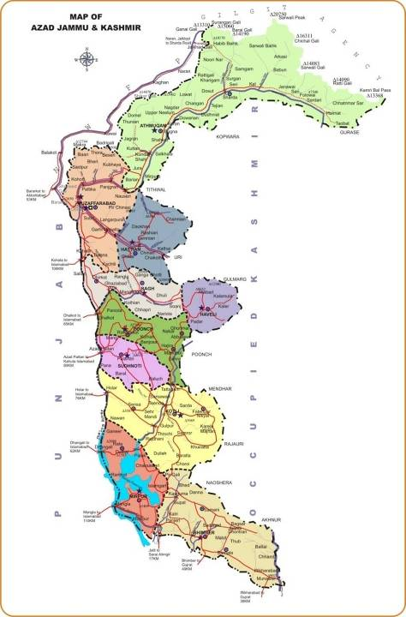
Neelum
Muzaffarabad
Muzaffarabad Div.
Hattian
Districts 10
Sub-divisions 32
Rev. Villages 1771
Bagh
Haveli
Poonch
Poonch Div
Sudhnoti
Kotli
Mirpur
Div
Mirpur
Bhimber

Slide 5
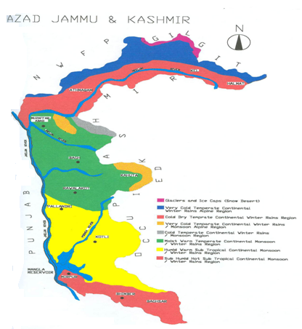
Climatic Zones of Azad Kashmir
1 | Glaciers and Ice Caps
2 | Very cold temperate non-monsoon alpine zone
3 | Cold temperate non-monsoon
4 | Very cold temperate monsoon alpine zone
5 | Cold temperate monsoon alpine zone
6 | Moist warm temperate
7 | Humid warm sub-tropical
8 | Sub-Humid hot sub-tropical
K P K

Slide 6
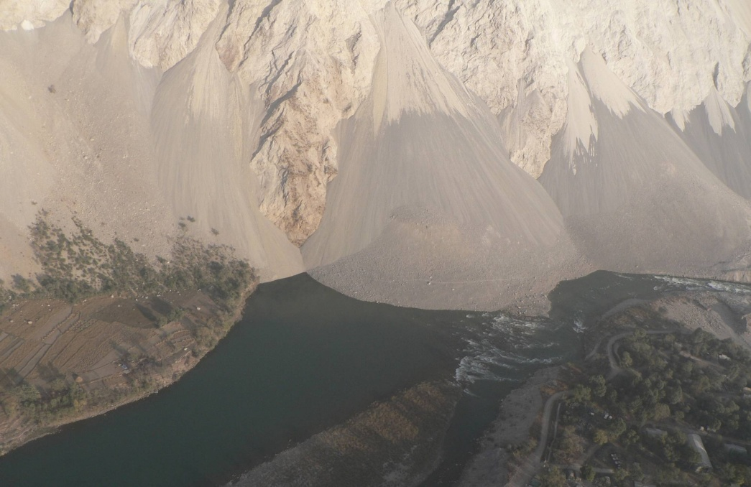
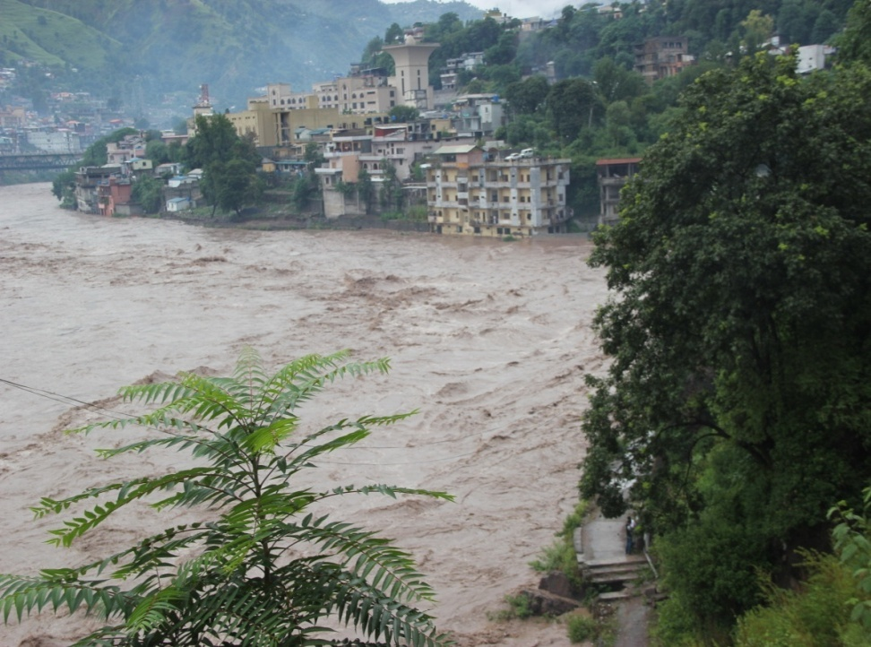
Monsoon Hazards/Threats
Torrential Rains
Flash Flooding/Floods
Land Slides/Mud Flows/Avalanches
Consequential Threats
Human ,Livestock Casualties and Shelter Losses
Road blockage, Collapse of Communication & electricity network
Loss of public and private properties
Population displacement
Livelihood Destruction and Food Insecurity
Health Issues

Slide 7
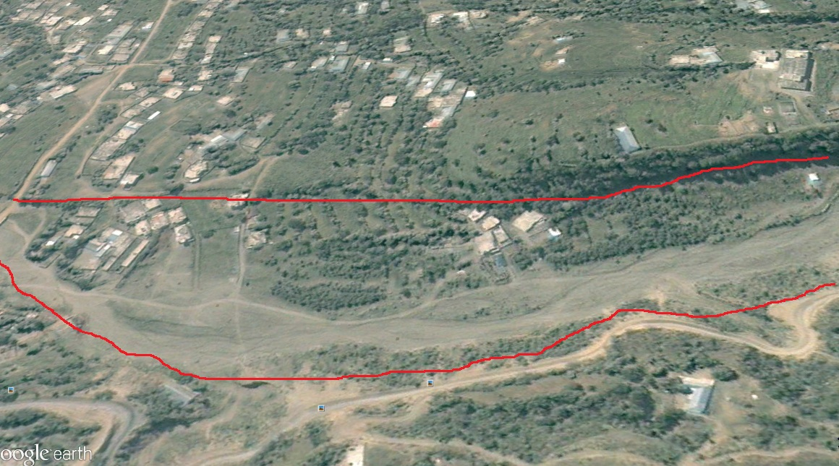
Monsoon Risk Enhancing Factors
Tempering with natural environment
Increased deforestation
Sand & stone mining
Unplanned construction of roads/cutting of hill slopes
Encroachments
Blockade of natural water ways
Illegal use of vulnerable/marginal land for habitation
Inadequate early warning arrangements
Non observation of early warning by general public
Gojra Nullah in 2005
Gojra Nullah in 2019

Slide 8
Monsoon Disaster History
Year | Affected Districts | Persons affected | Deaths | Injured | Houses Destroyed | Socio-Economic Loss
1992 | All Districts | 125,000 | 322 | 1,375 | 21,920 | Infrastructure, livestock, cash crops, orchards. A 1.25 million of population adversely affected
2006 | MZD and Bagh | 14 | 27 | 45 | 622 | Population of 31 villages affected
2010 | Neelum, MZD, Hattian, Bagh | 14,459 | 69 | 79 | 10,616 | Infrastructure, Livestock, Cash Crops, Environmental degradation /losses
2011 | Hattian | 1,300 | - | - | 49 | Infrastructure damages
2012 | All Districts | 12942 | 52 | 25 | 2,092 | Infrastructure, human and property losses besides environmental degradation
2013 | All Districts | 1,644 | 35 | 15 | 274 | Public & private property losses & environmental degradation
2014 | All Districts | 91,950 | 56 | 87 | 15,325 | 41 shops, 82 Water mills, 203 cattle, agricultural & Multi sectoral loses
2015 | All Districts | 2856 | 26 | 05 | 408 | 10 Shops, 06 Cattle,
2016 | All Districts | 9024 | 31 | 21 | 1409 | 43 shops, 21 Cattle
2017 | All Districts | 228 | 13 | 5 | 30 | Infrastructure damages
2018 | All Districts | 448 | 23 | 31 | 64 | 06 Vehicles,02 Cattle Sheds

Slide 9
Monsoon 2019
Weather Outlook for Monsoon 2019 (by PMD)
Most of the global models are indicating weak El-Nino conditions over Pacific Ocean and positive phase of Indian Ocean Dipole (IOD). Keeping in view, global and regional atmospheric circulations; following is the monsoon weather outlook for the year 2019.
Rainfall over the country as a whole for monsoon, 2019 (July-Sep) is likely to remain Near Normal.
Normal to above normal rainfall is expected in upper half of Pakistan due to strong incursion of monsoon currents and their interaction with westerly weather system. Extreme weather event is also expected during the period and may cause flooding in the rivers and its adjoining tributaries.

Slide 10
Plan Methodology
Bottom up Approach
Federal
Level
State Level (SDMA)
District Level
Ownership by Local Authorities (DDMAs)
Divisional Level

Slide 11
Contingency Planning
Keeping in view the worst case scenario and based on past experience, SDMA chalked out a Monsoon Contingency Plan–2019 in consultation with all DDMAs, line departments and other stakeholders
Meetings of DDMA’s held by Deputy Commissioners to take all departments on board
District plans are prepared according to the template shared with Deputy Commissioners
Further consultation is planned in all the three Divisions
All concerned line departments and stakeholders are taken on-board to cope with any emergency situation in the coming Monsoon season

Slide 12
Roles and Responsibilities of Stakeholders
SDMA | Coordination with NDMA/Federal Govt. entities and Allied Departments NGOs/INGOs Provision of Logistic Support to all DDMAs To ensure follow ups and monitoring of emergency response activities
District Administration/ DDMA s | To ensure effective dissemination of Early Warnings, Evacuation of affected/distressed population Camp Management Provision of Food & Non Food Items in the camps Coordination with relevant departments for timely clearing of roads and communication facilities To ensure provision of essential services including health and relief services
Pakistan Army | To extend support in search & rescue operations Clearance & Rehabilitation of Road communications when and where ever their support is needed
Health Department | To ensure First Aid, all preventive measures and provision of medicines Establishment of Medical Camps and provision of Ambulance Service
Civil Defence/ Rescue 1122 | Fire Fighting, Search & Rescue operations by utilizing capacity of Municipalities and Development Authorities in case of emergency spill over Establishment of Flood Emergency Control Cell in respective districtis Keeping the volunteers on alert
Cont.

Slide 13
Roles and Responsibilities of Stakeholders
Police | Maintenance of Law & Order Situation To support in Dissemination of Early Warnings by DDMAs Assist the Search and Rescue operations
C &W | Clearance & Rehabilitation of Roads & Removal of Debris/Slides
NHA /FWO | Clearance of slides and Rehabilitation of Road communications under their operation and control
Electricity Department | Maintenance of power transmission lines to ensure un-interrupted electricity supply
Education Department | Provision of School Buildings for temporary setting up of IDPs camps
Utility Stores Corporation | Supply of Food Items at short notice by SDMA
UN/INGOs/NGOs | To coordinate and provide active support to SDMA for assessment and evacuation of vulnerable families Provision of Food & NFIs, Tents & Medicines Provision of WASH & WATSAN Facilities for IDPs To ensure all types of humanitarian assistance as per mandate and resource availability
Cont.

Slide 14
Roles and Responsibilities of Stakeholders
Food Department | Keeping stock of wheat available as per the requirement at various places in the State
Information Department | Broadcast advance warnings to sensitize the public Guide the public about the nearby safer places, routes and other precautionary measures Publication of the flood-related reports on daily-basis in the local, regional and national newspapers Arrange press briefings/press conferences for any officer/official
Local Government & Rural Development Department | Arrange potable drinking water and sanitation facilities for flood affected areas Arrange for the removal of carcasses and debris after floods Immediate restoration of water supply, sanitation, cause ways, culverts, links roads, street lights and public latrines Coordinate with humanitarian agencies i.e, INGOs, NGOs and UN agencies to make up the short falls Arrange for requisite Water and Sanitation in all the earmarked evacuation centers in coordination with education department
Board of Revenue | Recovery Need Assessment Damage Need Assessment Coordination for early recovery & rehabilitation

Slide 15
Response
Coordination and Operation
SDMA will play a lead role during monsoon emergency in AJK - focal point for coordination
State level Emergency Operation Center (SEOC) will remain active and operational 24/07 for coordination among all the districts
SEOC will keep close contact with Pakistan MET department, NDMA, Pakistan Army, UN agencies, Red Crescent and all other concerned stakeholders
District control rooms have been established by DDMA’s and will remain active and operational round the clock
All the departments have their own contingency plans & control rooms

Slide 16
Early Warning Mechanism
Pak Metrological Department
SMS
Federal Flood
Commission
WhatsApp Group
Telephone-Fax
NDMA
SMS
SDMA
WhatsApp Group
Telephone, Fax, Wireless
Wireless
DDMA
Public Announcement
Telephone, Fax

Slide 17
Anticipated Flood Response Measures
Rescue Operation (1122, Police, Army)
Re-opening of Road Communication (Works Dept,Army,NHA)
Food Security for affected population (Food Dept, SDMA)
Provision of Health Services (Health, NGOs)
Emergency Response Stockpiling (NDMA,SDMA, PRCS)
IDP Camps and Emergency Shelters (DDMA, PRCS, NGOs)
WASH and WATSAN Facilities in Relief Camps (Local Govt,NGOs)
Food and Non-food items for IDPs (SDMA,Food Dept,NGOs)

Slide 18
Overall Anticipated Caseload
Sr. No. | District | Anticipated Case Load (Families) | Vulnerable Areas
01 | Muzaffarabad | 980 | Makri, Lower Plate Walkway, Taali Mandi, Shahsultan, Saheli Sarkar Bridge, Gulshan Pir Allodin , Tariqabad, ManakPayeyan
02 | Jehlum Valley | 1560 | Khilana, Gujarbandi, Chakhama , Hattian, Chinari , Chikar, Banna Mula, Lamnia, Salmia, Saina Daman
03 | Neelum | 1330 | Chilihana,Katha Semari, Jura,Sosal Bandi Laswa Sharda, Kharigam,Surgan Bakwali,Gamote,
04 | Rawalakot | 1027 | Harkarian, Bela, Dharian Zeerian, Chak , Potha Bala, Kanoli,Numal, Miana Na Mora,Beroti,Bandi Dhalkot
05 | Bagh | 1500 | Grid Colony Bagh,Refugee Camp, Mang Bajri Village Bees Bagla ,Thub, Village Minhasa , Mala Bagla , Salian Dhondan Dhirkot,Gojar Kohallah
06 | Haveli | 1540 | Chanjal , Bahdi ,Jokan, Quaid-i-Abad, Hillan Kalamulla Khurshidabad,
07 | Sudhnoti | 280 | Pallandri to Trarkhal Road, Pallandri to Rawalpindi Road
08 | Mirpur | 415 | Saim, lehri, Azizpur , Kharikhas,Bega Bilawal, Takipur,Shahpur, Pakhral, Chabriya Dattan, Dhok meri
09 | Bhimber | 235 | Bhimber City, Ghura Din, Randyam , Kasghuma, Smahni Choki , Tonin , Barnala, Kadhala , Lakarmandi
10 | Kotli | 545 | Thalair Colony, Dakhari, Juzwi Mandi, Choch, Holar,Majjan, Jahndroot, Manoli Nala,Nala, Nala Kala Dabb
Total |  | 9412

Slide 19
Preparedness
Preparedness – Available Stocks with SDMA (NFIs)
Sr. No | Item | Qty
01 | Tent | 842
02 | Foam Seat 3x3 | 415
03 | Sleeping Bags | 1409
04 | Plastic Mats (Different Size) | 4450
05 | Plastics Sheets | 317
06 | Blanket | 1538
07 | Ladies Shawl | 1045
08 | Generator 2 KVA 3.5 KVA 5 KVA 50 KVA Total | 77 15 06 02 100
09 | Water Filtration Plant | 07

Slide 20
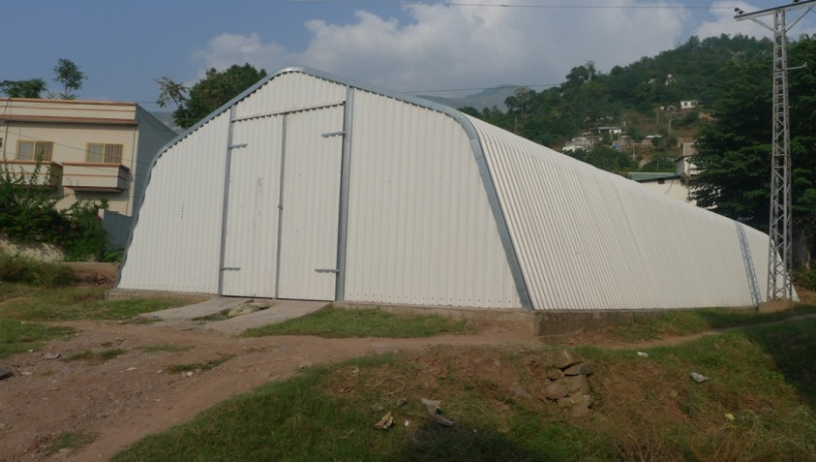
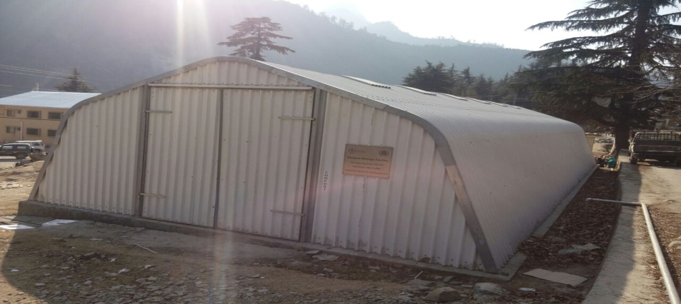
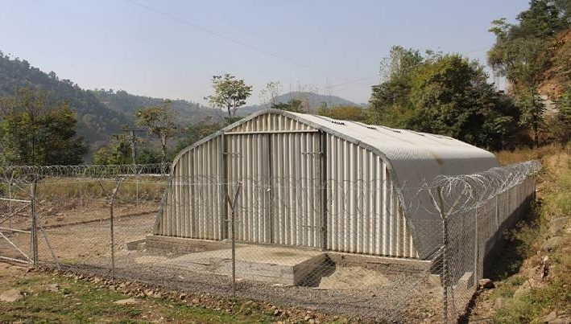
Preparedness
Logistic Arrangement
DDMAs Warehouse (All Districts)
SDMA Warehouse
NDMA Warehouse
Trucks (Fleet of Five (05) mini trucks with courtesy of WFP)
Muzaffarabad
Neelum
Bagh

Slide 21
Preparedness
Preparedness – Available Machinery
Items | Mzd | Jhelum Valley | Bhimber | Sudhnuti | Haveli | Rw.kot | Bagh | Neelum | Kotli | Mirpur
Crawler Dozer | 0 | 2 | 1 | 2 | 1 | 2 | 1 | 0 | 0
Wheel Loader | 3 | 2 | 0 | 0 | 2 | 3 | 2 | 2 | 2
Excavator | 5 | 1 | 0 | 0 | 1 | 2 | 1 | 2 | 1
Motor Grader | 1 | 0 | 0 | 0 | 0 | 0 | 0 | 9 | 0 | 01
Dump Truck | 13 | 1 | 0 | 1 | 1 | 1 | 1 | 4 | 1
Uni-mog Trailer | 0 | 0 | 0 | 0 | 0 | 6 | 3 | 0 | 0 | 10
Air Compressor | 0 | 0 | 0 | 0 | 0 | 0 | 0 | 0 | 1
Cargo Crane | 1 | 0 | 0 | 0 | 0 | 0 | 0 | 0 | 0
Ambulance | 18 | 10 | 55 | 1 | 5 |  |  | 15 | 42 | 43
Fire Tender | 5 | 1 | 0 | 2 | 1 | 02 | 1 | 1 | 2
Boats with OBM | 0 | 0 | 0 | 0 | 0 | 0 | 0 | 0 | 0

Slide 22
Relief Stock Pre-positioning in Districts
District | Tents | Water Filter | Plastic Sheets | Plastic Mats | Blankets | Shawls | Shelter Box | Sleeping Bag | Jackets | Steel Bucket
Poonch | 47 | 0 | 0 | 18 | 09 | 0 | 01 | 48 | 0 | 0
Bagh | 22 | 0 | 4 | 0 | 0 | 40 |  | 10 | 0 | 0
Bhimber | 270 | 0 | 295 | 0 | 430 | 0 | 0 | 48 | 0 | 0
MZD | Available With SDMA
Jehlum Valley | 30 | 0 | 0 | 60 | 103 | 0 | 0 | 21 | 0 | 0
Neelum | 65 | 0 | 0 | 150 | 20 | 140 | 0 | 30 | 0 | 0
Sudhnuti | 50 | 05 | 05 | 11 | 150 | 50 | 02 | 05 | 0 | 0
Kotli | 300 | 0 | 120 | 190 | 100 | 100 | 0 | 80 | 0 | 0
Mirpur | 100 | 03 | 100 | 60 | 200 | 100 | 02 | 30 | 0 | 0
Haveli | 30 | 0 | 0 | 15 | 95 | 75 | 0 | 0 | 0 | 0

Slide 23
Health Facilities with Bed Strength in AJK
Muzaffarabad Division
Institution | No of Beds | No of RHCS | No of Beds
CMH | 250 | 6 | 72
AIMS | 300 | 0 | 0
THQ Hattian | 50 | 6 | 72
Neelum Hosp | 60 | 1 | 12
THQ Kel | 30 | 0 | 0
MDF Jumber | 50 | 0 | 0
Total MZD Div | 740 | 13 | 156
Mirpur Division
Div Hospital Mirpur | 400 | 5 | 60
THQ Dudyal | 100 | 0 | 0
New Mirpur City | 100 | 0 | 0
DHQ Hospital Kotli | 230 | 7 | 84
THQ Sehansa | 50 | 0 | 0
THQ Nikyal | 50 | 0 | 0
THQ khoi Ratta | 30 | 0 | 0
THQ Charhoi | 50 | 0 | 0
DHQ Hosp. Bhim | 150 | 3 | 36
THQ Hosp. BurNala | 50 | 0 | 0
Total Mirpur Div | 1210 | 15 | 180
Poonch Division
CMH Rawlakot | 250 | 7 | 84
THQ Hajeera | 50 | 0 | 0
DHQ Bagh | 150 | 10 | 120
CDH Hill | 50 | 0 | 0
THQ dhirkot | 50 | 0 | 0
DHQ Pallandri | 100 | 3 | 36
Civ. Hospital Trarkhal | 20 | 0 | 0
THQH Kahuta (Haveli) | 50 | 1 | 12
Total Poonch Div | 720 | 21 | 252
Grand Total | 2670 | 49 | 588

Slide 24
District Wise Requirement of Non Food Items
District | Tents with P.Sheets | Matris | Plastic Mats | Blanket | Kitchen set | Hygiene Kits
Muzaffarabad | 980 | 900 | 980 | 1960 | 400 | 500
Jhelum Valley | 1560 | 750 | 800 | 3000 | 250 | 250
Neelum | 1330 | 900 | 1000 | 2000 | 800 | 500
Rawalakot | 1027 | 1000 | 800 | 1500 | 300 | 250
Bagh | 1500 | 1200 | 900 | 1700 | 1500 | 750
Haveli | 1540 | 1000 | 800 | 1600 | 350 | 750
Sudhnoti | 280 | 100 | 150 | 200 | 100 | 150
Mirpur | 415 | 150 | 150 | 300 | 250 | 200
Bhimber | 235 | 185 | 170 | 200 | 200 | 150
Kotli | 545 | 500 | 500 | 400 | 100 | 150
Total | 9412 | 6685 | 6250 | 12860 | 4250 | 3650

Slide 25
Stock Position of Food Department
Name of Station | Wheat Balance (in tons)
Base Godown Islamabad | 6167
UK Mills Rawat | 299
Mangla Flour Mills Mirpur | 1044
Pak Kashmir Flour Mills Dudyal | 1390
Saddique Flour Mills Jatlan | 1039
Total | 9939
Neelum Flour Mills Mzd | 309
Gillani Flour Mills Kohala | 854
Poonch Flour Mills Arja | 337
Jadded Flour Mills Gorah | 387
Sadozai F.M.A Patan | 819
Itfaq Flour Mills Sensa | 511
Total | 3217
G.Total | 13156
Utility Stores has shared its storage status and network in AJK

Slide 26
Food Items Required
Sr.No | District | Relief Caseload | Food(MTs) for 3 months
1 | Muzaffarabad | 980 | 395.136
2 | Jehlum Valley | 1560 | 628.992
3 | Neelum | 1330 | 536.256
4 | Rawalakot | 1027 | 414.0864
5 | Bagh | 1500 | 604.8
6 | Haveli | 1540 | 620.928
7 | Sudhnoti | 280 | 112.896
8 | Mirpur | 415 | 167.328
9 | Bhimber | 235 | 94.752
10 | Kotli | 545 | 219.744
Total |  | 9412 | 3794.918

Slide 27
Details of EOCs Established
Department | Focal Person | Emergency Control Room No
SDMA Muzaffarabad | Moazzam Zafar | 05822-921643, 0300-9869094
DDMA Muzaffarabad | Umar Qureshi | 052822-920055, 03460266956
DDMA Neelum | Akhtar Ayub | 05821-920001, 0355-8126666
DDMA Rawalakot | Rubiya Kanwal | 05824-920052, 0348-5524670
DDMA Bagh | Waqas Saleem | 05823-920046, 0342-8909449
DDMA Haveli | Zaheer Khan | 05823-921708, 0333-5506612
DDMA Sudhnoti | Sania Qamar | 05825-920011, 0310-9185530
DDMA Mirpur | Noman Hussain | 05827-921270, 03466084791
DDMA Bhimber | Mubashir Mushtaq | 05828-920220, 0343-7707523
DDMA Jehlum Valley | Naqash Mushtaq | 05822-922607, 0312-9033868
DDMA Kotli | Shariq Talat | 05826-920164, 0307-5533133

Slide 28
Details of Department’s Control Room for Monsoon
Department | Focal Person | Emergency Control Room No
PPH | Khuwaja Abdul Basit (SE) | 05827-920069 , 0355-6751854
MCM –MZD | Khawaja Azam Rasool ( Administrator) | 05822-920839, 0345-9472675
Sport, Youth & Culture MZD | Qazi Abdul Basit (Asst. Eng) | 05822,921568, 0342-5141452
Elementary & Secondary Education | Abdul Shakoor Siddique (Director) | 05822-960003,0300-5199234
Health Deptt. | Dr. Tanveer Shafi (Asst. Director Health) | 05822,920171, 0334-5277866
Agriculture Department | Raja Muhammad Asif Khan (Director Aggri-Ext ) | 05822-920641, 0300-5305781
Police | Control Room | 05822-930419

Slide 29
Gaps/Additional Requirements
NHA needs to setup well equipped road clearing units between Kohala to Chakothi and other roads under its operation and control
NDMA is requested to help bridge gaps in terms of NFIs and FIs (if possible) to ensure preparedness for anticipated caseload
NDMA may also extend its support in resource availability to carry out mitigation and response measures for ensuring effective management of hazards and associated threats
Provision of Water Rescue Equipment from NDMA

Slide 30
THANK YOU
Designed & Developed by Syed I. Kazmi (UNDP/NDMA Coordination Officer for SDMA)

