Slide 2
Monsoon Contingency Plan 2021
State Disaster Management Authority

Slide 3
Vital Statistics
Area | 5,134 Square Miles (13,297 square Km)
Population | 4.179 million*
Gender Ratio (Number of males per 100 females) | 101.2*
Average Family Size | 6.7 Members
Rural - Urban Ratio | 83:17 (MICS 2017)
Growth Rate | 1.9%***
Literacy Rate | 76.6% *
Mean Annual Rain Fall | 1,000 -2,000 mm**
Area comprises of difficult mountains and rugged terrain with some stretches of plains
Steep slopes, complex geological structures with active tectonic processes are main geographical features. The land is blessed with snow covered mountains, thick green forests, fast flowing rivers and streams
Landslides and water induced disasters are the common phenomenon in the region due to climate system with great seasonality in rainfall
*Planning and Development Department
** Statistics Section, Planning & Development Department, GoAJK
***Population Welfare Department, GoAJK

Slide 4
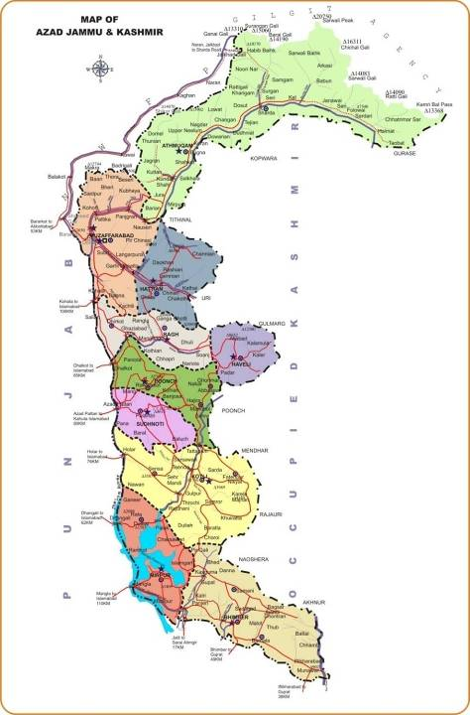
Neelum
Muzaffarabad
Muzaffarabad Div.
Hattian
Districts 10
Sub-divisions 32
Rev. Villages 1771
Bagh
Haveli
Poonch
Poonch Div
Sudhnoti
Kotli
Mirpur
Div
Mirpur
Bhimber

Slide 5
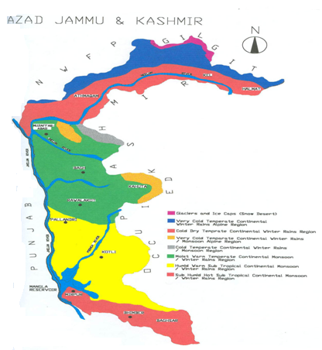
Climatic Zones of Azad Kashmir
1 | Glaciers and Ice Caps
2 | Very cold temperate non-monsoon alpine zone
3 | Cold temperate non-monsoon
4 | Very cold temperate monsoon alpine zone
5 | Cold temperate monsoon alpine zone
6 | Moist warm temperate
7 | Humid warm sub-tropical
8 | Sub-Humid hot sub-tropical
K P K

Slide 6
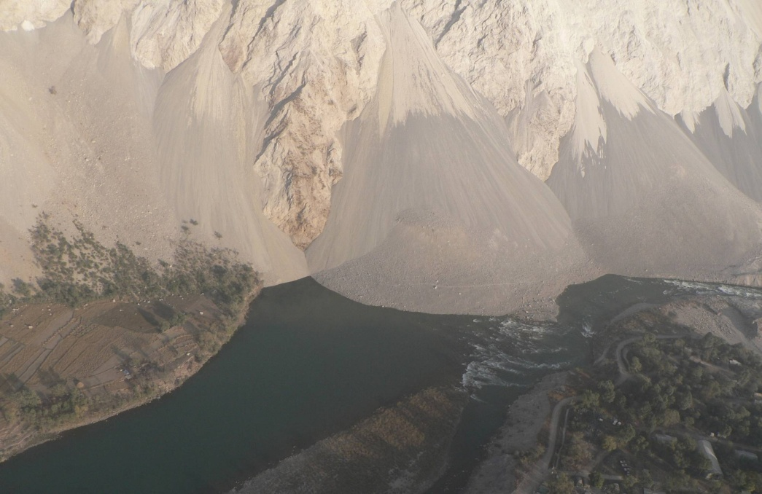
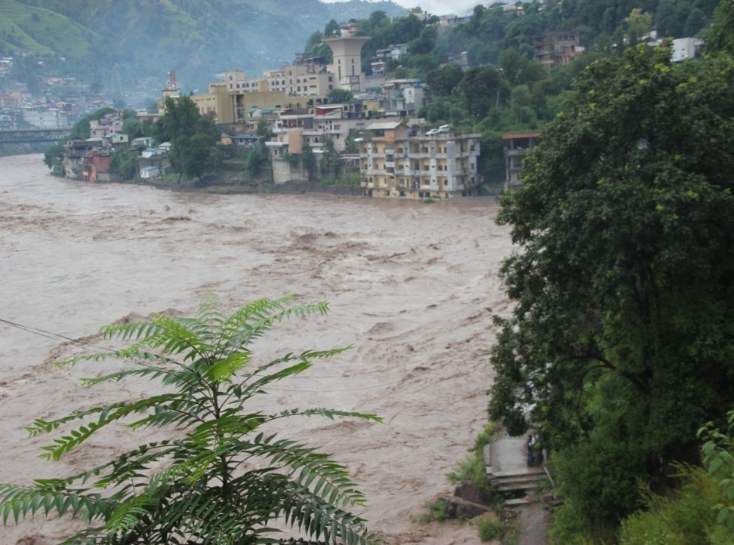
Monsoon Hazards/Threats
Torrential Rains
Flash Flooding/Floods
Land Slides/Mud Flows/Avalanches
Consequential Threats
Human ,Livestock Casualties and Shelter Losses
Road blockage, Collapse of Communication & electricity network
Loss of public and private properties
Population displacement
Livelihood Destruction and Food Insecurity
Health Issues

Slide 7
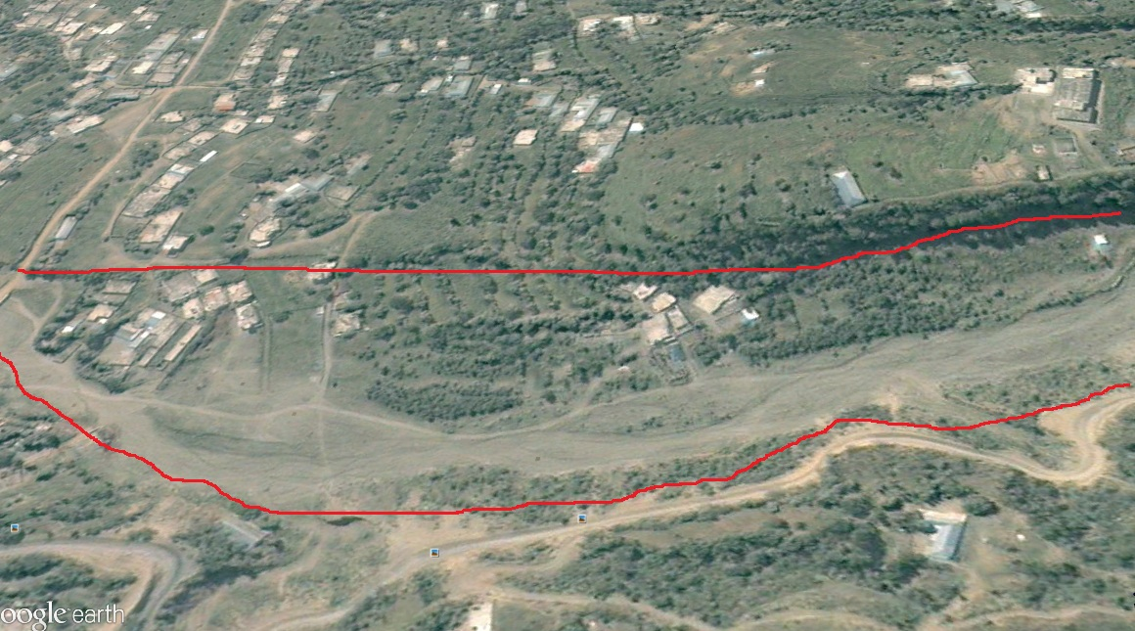
Monsoon Risk Enhancing Factors
Gojra Nullah in 2005
Tempering with natural environment
Increased deforestation
Sand & stone mining
Unplanned construction of roads/cutting of hill slopes
Encroachments
Blockade of natural water ways
Illegal use of vulnerable/marginal land for habitation
Inadequate early warning arrangements
Non observation of early warning by general public
Gojra Nullah in 2021

Slide 8
Monsoon Disaster History
Year | Affected Districts | Persons affected | Deaths | Injured | Houses Destroyed | Socio-Economic Loss
1992 | All Districts | 125,000 | 322 | 1,375 | 21,920 | Infrastructure, livestock, cash crops, orchards. A 1.25 million of population adversely affected
2006 | MZD and Bagh | 14 | 27 | 45 | 622 | Population of 31 villages affected
2010 | Neelum, MZD, Hattian, Bagh | 14,459 | 69 | 79 | 10,616 | Infrastructure, Livestock, Cash Crops, Environmental degradation /losses
2011 | Hattian | 1,300 | - | - | 49 | Infrastructure damages
2012 | All Districts | 12942 | 52 | 25 | 2,092 | Infrastructure, human and property losses besides environmental degradation
2013 | All Districts | 1,644 | 35 | 15 | 274 | Public & private property losses & environmental degradation
2014 | All Districts | 91,950 | 56 | 87 | 15,325 | 41 shops, 82 Water mills, 203 cattle, agricultural & Multi sectoral loses
2015 | All Districts | 2856 | 26 | 05 | 408 | 10 Shops, 06 Cattle,
2016 | All Districts | 9024 | 31 | 21 | 1409 | 43 shops, 21 Cattle
2017 | All Districts | 228 | 13 | 5 | 30 | Infrastructure damages
2018 | All Districts | 448 | 23 | 31 | 64 | 06 Vehicles,02 Cattle Sheds
2019 | All Districts | 924 | 42 | 18 | 132 | 04 School 43 shops, 69 Cattle, 23 Mills,
2020 | All Districts | 1176 | 12 | 09 | 168 | 03 School 02 shops, 11 Cattle, 23 Mills,

Slide 9
Weather Outlook for Monsoon
(July –September by PMD)
Monsoon rainfall is expected to remain near to normal during July to September 2021 in Pakistan. The State of Jammu & Kashmir is likely to receive moderately above normal rainfall during the season.

Slide 10
Plan Methodology
SDMA chalked out Monsoon Contingency Plan–2020 in consultation with all DDMAs, line departments and other stakeholders, keeping in view the worst case scenario and past experience.
Federal
Level
State Level (SDMA)
District Level
(DDMAs)
Divisional Level

Slide 11
Plan Approval/Dissemination
District plans prepared and presented in State level Monsoon Coordination meeting held on 9th June 2021
State level Monsoon Contingency Plan prepared and submitted for approval
All the stakeholders directed to ensure better preparedness and requisite mitigation measures
The Plan with necessary directions be disseminated to all line departments and concerned stakeholders to cope with any emergency situation in the coming Monsoon season

Slide 12
Overall Anticipated Caseload
Sr. | District | Vulnerable Families | Vulnerable Areas
01 | Muzaffarabad | 3630 | Makri, Lower Plate Walkway, Taali Mandi, Shahsultan, Saheli Sarkar Bridge, Gulshan Pir Allodin , Tariqabad, ManakPayeyan
02 | Jehlum Valley | 1505 | Khilana, Gujarbandi, Chakhama , Hattian, Chinari , Chikar, Banna Mula, Lamnia, Salmia, Saina Daman
03 | Neelum | 2078 | Chilihana,Katha Semari, Jura,Sosal Bandi Laswa Sharda, Kharigam,Surgan Bakwali,Gamote,
04 | Rawalakot | 1127 | Harkarian, Bela, Dharian Zeerian, Chak , Potha Bala, Kanoli,Numal, Miana Na Mora,Beroti,Bandi Dhalkot
05 | Bagh | 1500 | Grid Colony Bagh,Refugee Camp, Mang Bajri Village Bees Bagla ,Thub, Village Minhasa , Mala Bagla Salian Dhondan Dhirkot,Gojar Kohallah
06 | Haveli | 1570 | Chanjal , Bahdi ,Jokan, Quaid-i-Abad, Hillan Kalamulla Khurshidabad,
07 | Sudhnoti | 250 | Pallandri to Trarkhal Road, Pallandri to Rawalpindi Road
08 | Mirpur | 500 | Sahang,Khliqabad,Jatlan,Newcxity,Pullmanda,Khari,Kharrak,Nakka,
09 | Bhimber | 1640 | Bhimber City, Ghura Din, Randyam , Kasghuma, Smahni Choki , Tonin , Barnala, Kadhala , Lakarmandi
10 | Kotli | 545 | Thalair Colony, Dakhari, Juzwi Mandi, Choch, Holar,Majjan, Jahndroot, Manoli Nala,Nala, Nala Kala Dabb
Total |  | 14345

Slide 13
Response
Coordination and Operation
SDMA will play a lead role during monsoon emergency in AJK - focal point for coordination
State level Emergency Operation Center (SEOC) will remain active and operational 24/07 for coordination among all the districts
SEOC will keep close contact with Pakistan MET department, NDMA, Pakistan Army, UN agencies, Red Crescent and all other concerned stakeholders
District control rooms have been established by DDMA’s and will remain active and operational round the clock
All the departments have their own contingency plans & control rooms

Slide 14
Anticipated Flood Response Measures
Rescue Operation (1122, Police, Army)
Re-opening of Road Communication (Works Dept,Army,NHA)
Food Security for affected population (Food Dept, SDMA)
Provision of Health Services (Health, NGOs)
Emergency Response Stockpiling (NDMA,SDMA, PRCS)
IDP Camps and Emergency Shelters (DDMA, PRCS, NGOs)
WASH and WATSAN Facilities in Relief Camps (Local Govt,NGOs)
Food and Non-food items for IDPs (SDMA,Food Dept,NGOs)

Slide 15
Roles and Responsibilities of Stakeholders
SDMA | Coordination with NDMA/Federal Govt. entities and Allied Departments NGOs/INGOs Provision of Logistic Support to all DDMAs To ensure follow ups and monitoring of emergency response activities
District Administration/ DDMA s | To ensure effective dissemination of Early Warnings, Evacuation of affected/distressed population Camp Management Provision of Food & Non Food Items in the camps Coordination with relevant departments for timely clearing of roads and communication facilities To ensure provision of essential services including health and relief services
Pakistan Army | To extend support in search & rescue operations Clearance & Rehabilitation of Road communications when and where ever their support is needed
Health Department | To ensure First Aid, all preventive measures and provision of medicines Establishment of Medical Camps and provision of Ambulance Service
Civil Defence/ Rescue 1122 | Fire Fighting, Search & Rescue operations by utilizing capacity of Municipalities and Development Authorities in case of emergency spill over Establishment of Flood Emergency Control Cell in respective districts Keeping the volunteers on alert
Cont.

Slide 16
Roles and Responsibilities of Stakeholders
Police | Maintenance of Law & Order Situation To support in Dissemination of Early Warnings by DDMAs Assist the Search and Rescue operations
C &W | Clearance & Rehabilitation of Roads & Removal of Debris/Slides
NHA /FWO | Clearance of slides and Rehabilitation of Road communications under their operation and control
Electricity Department | Maintenance of power transmission lines to ensure un-interrupted electricity supply
Education Department | Provision of School Buildings for temporary setting up of IDPs camps
Utility Stores Corporation | Supply of Food Items at short notice by SDMA
UN/INGOs/NGOs | To coordinate and provide active support to SDMA for assessment and evacuation of vulnerable families Provision of Food & NFIs, Tents & Medicines Provision of WASH & WATSAN Facilities for IDPs To ensure all types of humanitarian assistance as per mandate and resource availability
Cont.

Slide 17
Roles and Responsibilities of Stakeholders
Food Department | Keeping stock of wheat available as per the requirement at various places in the State
Information Department | Broadcast advance warnings to sensitize the public Guide the public about the nearby safer places, routes and other precautionary measures Publication of the flood-related reports on daily-basis in the local, regional and national newspapers Arrange press briefings/press conferences for any officer/official
Local Government & Rural Development Department | Arrange potable drinking water and sanitation facilities for flood affected areas Arrange for the removal of carcasses and debris after floods Immediate restoration of water supply, sanitation, cause ways, culverts, links roads, street lights and public latrines Coordinate with humanitarian agencies i.e, INGOs, NGOs and UN agencies to make up the short falls Arrange for requisite Water and Sanitation in all the earmarked evacuation centers in coordination with education department
Board of Revenue | Recovery Need Assessment Damage Need Assessment Coordination for early recovery & rehabilitation

Slide 18
Early Warning Mechanism
Pak Metrological Department
SMS
Federal Flood
Commission
WhatsApp Group
Telephone-Fax
NDMA
SMS
SDMA
WhatsApp Group
Telephone, Fax, Wireless
Wireless
DDMA
Public Announcement
Telephone, Fax

Slide 19
Structural Flood Protection Mitigation Measures
under DCRIP

Slide 20
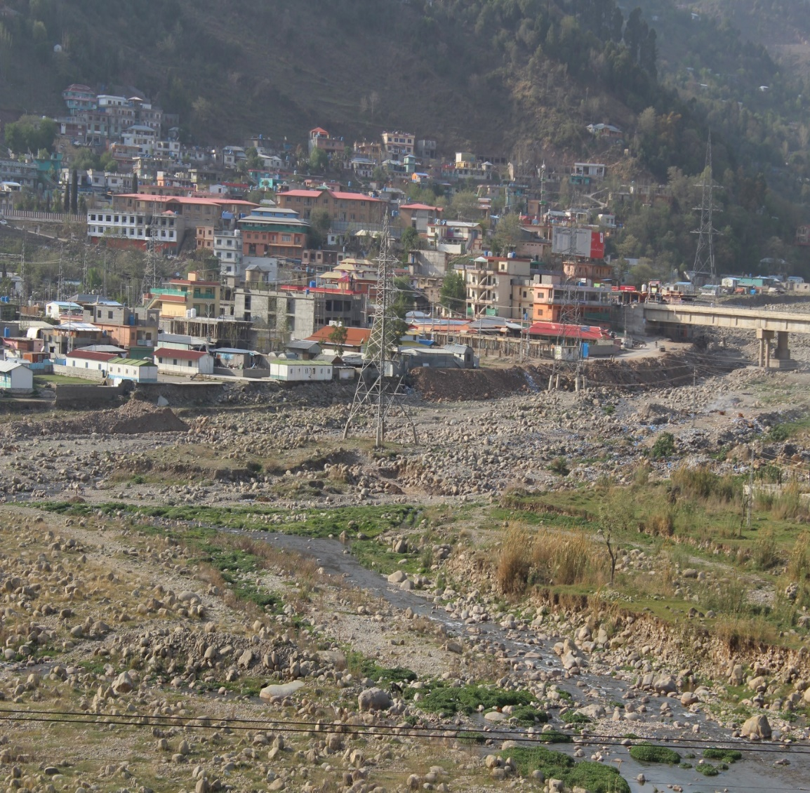
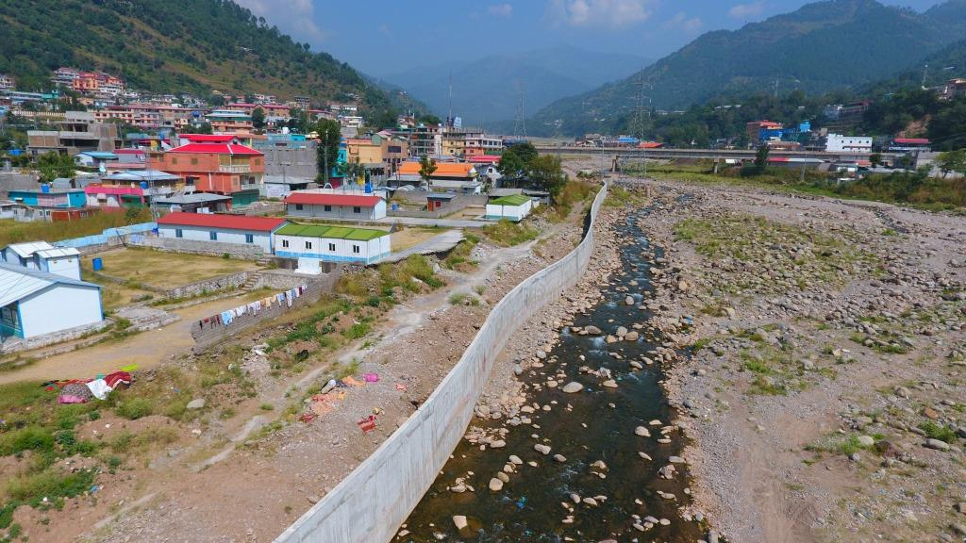
Bani Pasari
Before
After
Flood Protection Retaining Wall

Slide 21
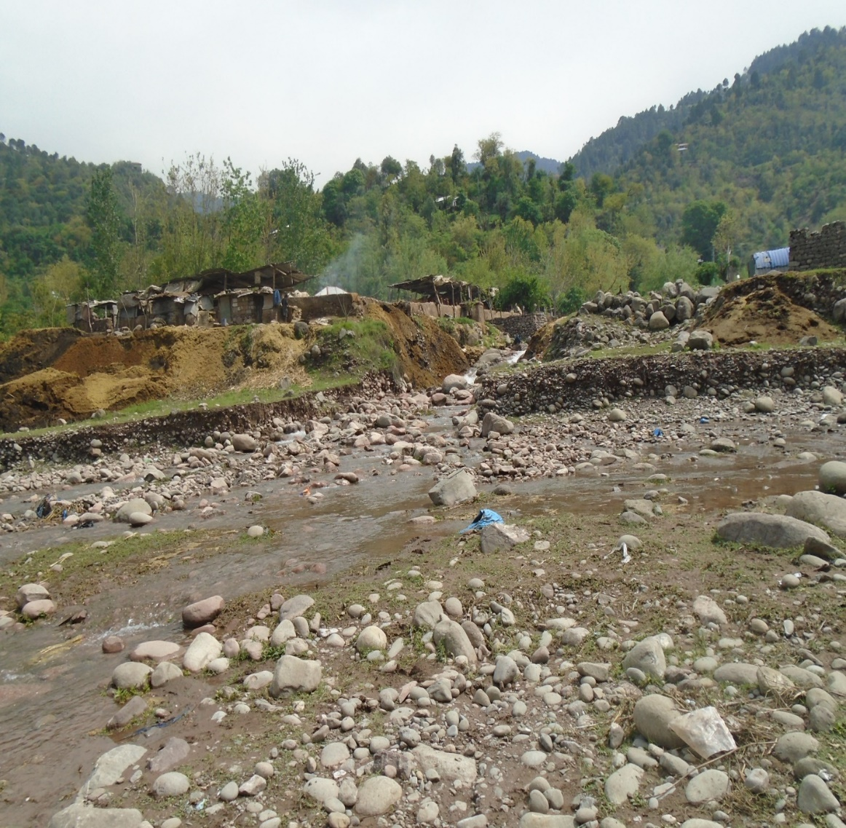
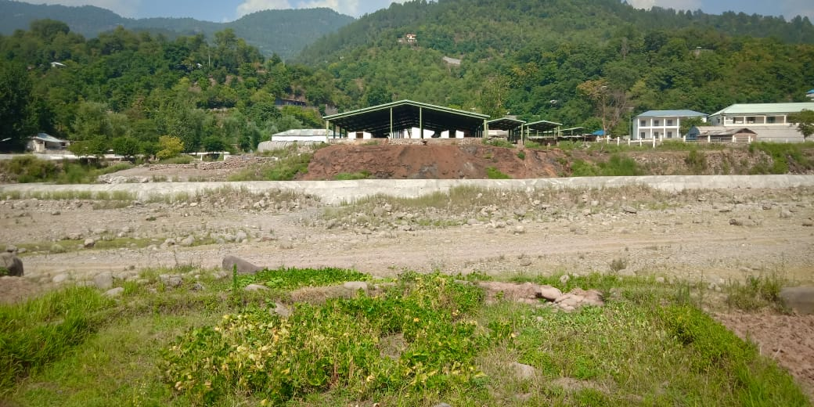
Mong Bajri
Before
After
Flood Protection Wall

Slide 22
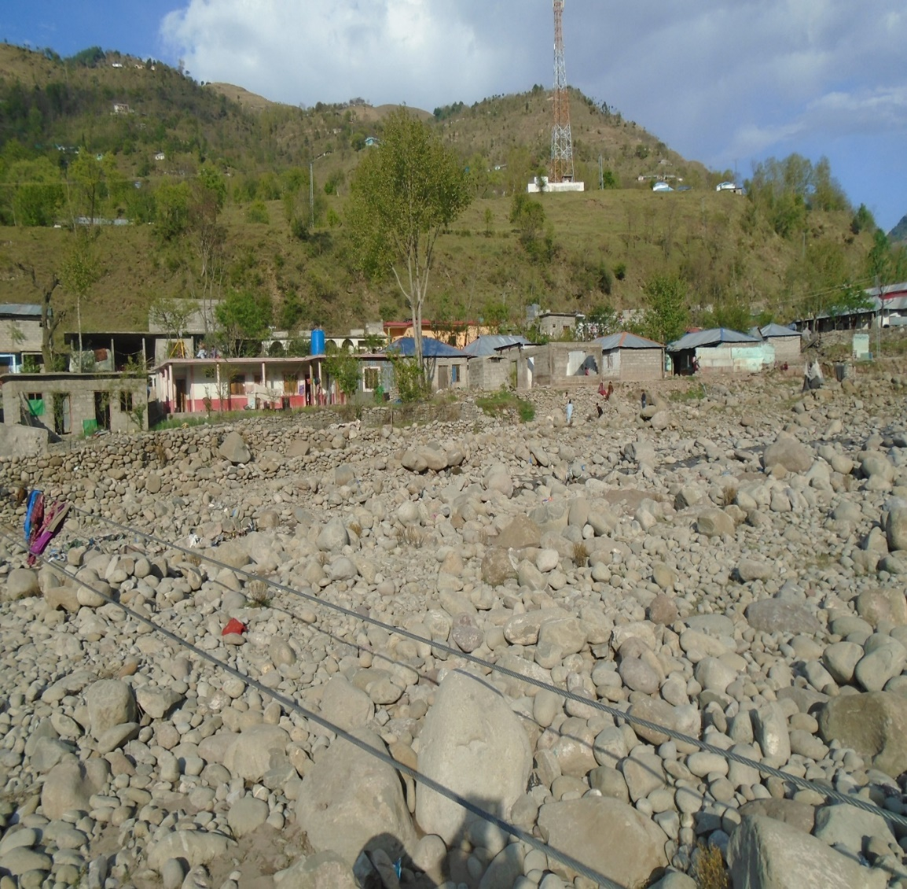
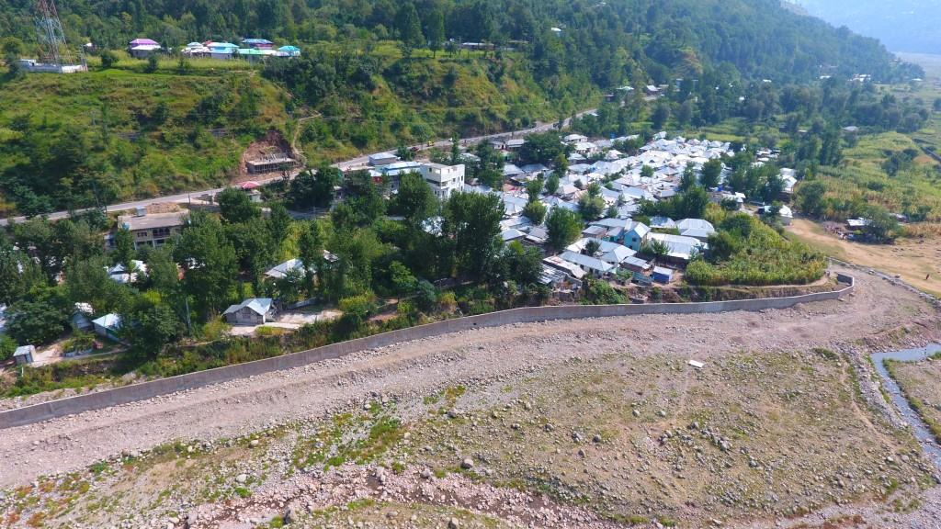
Chatter-II
Before
After
Flood Protection Wall

Slide 23
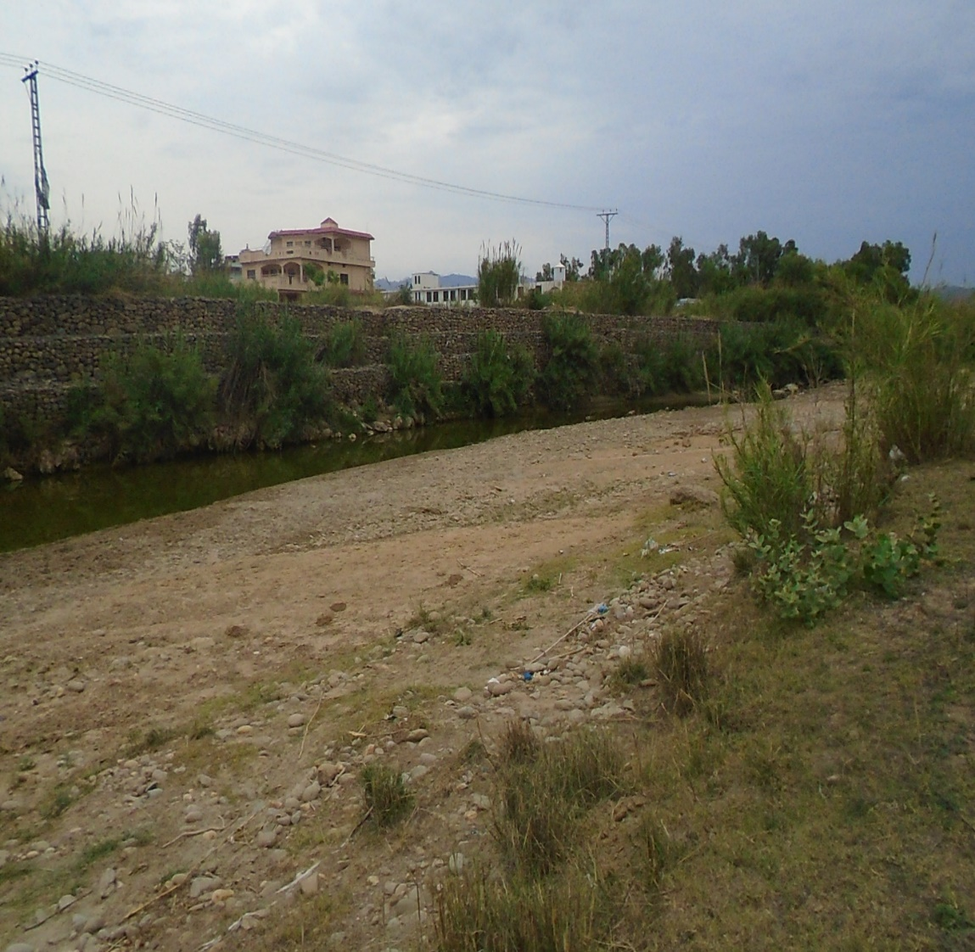
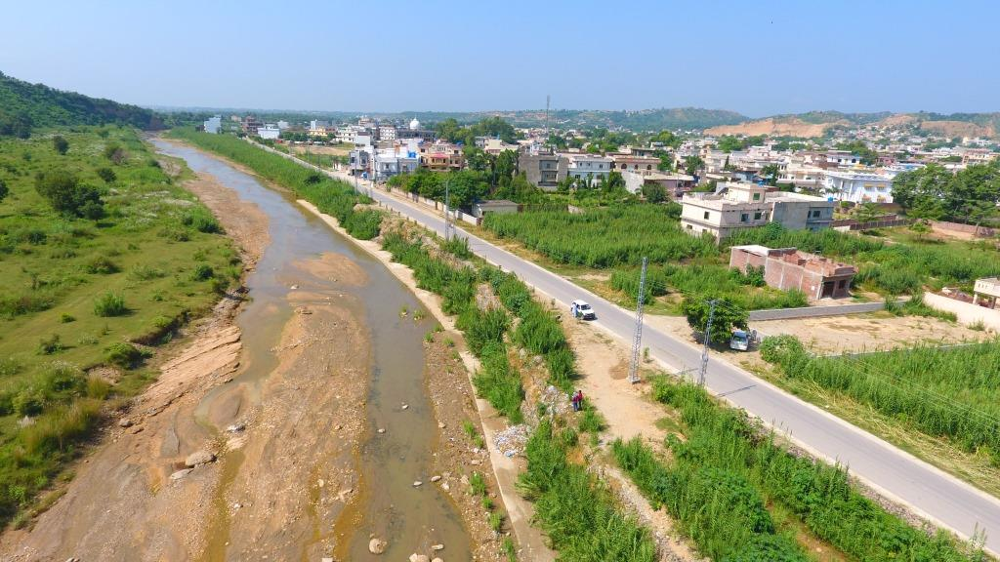
Bhimber Nullah
Before
After
Apron for Existing Wall

Slide 24
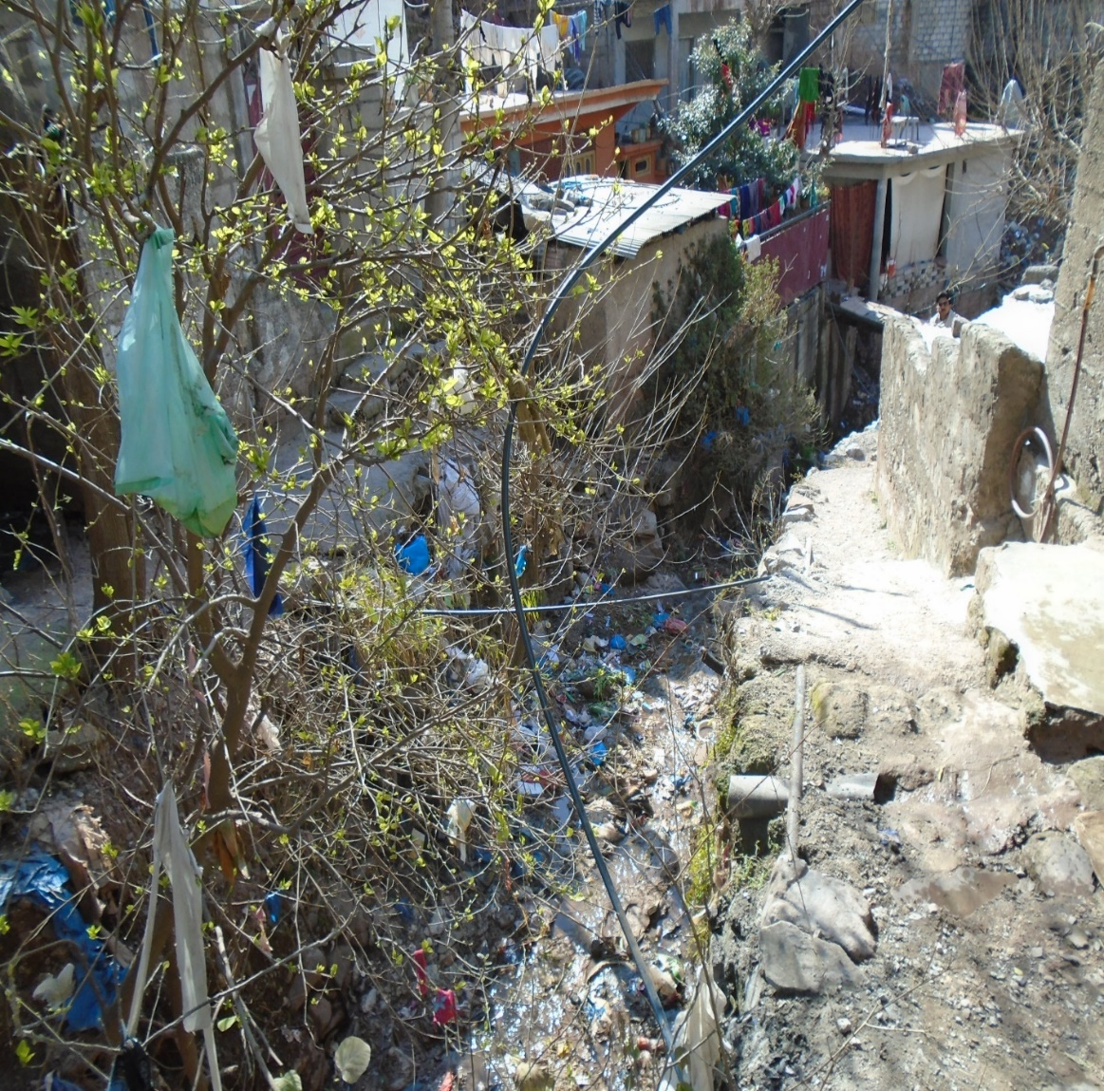
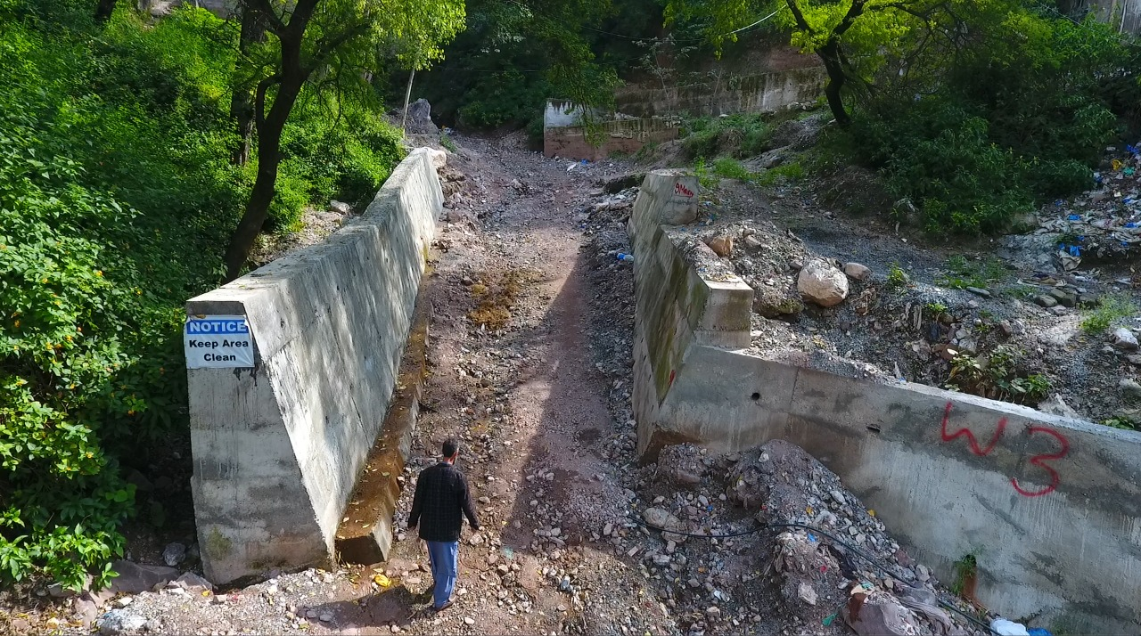
Forests
Before
After
Construction of Protection Walls

Slide 25
State of Preparedness
Resources Available

Slide 26
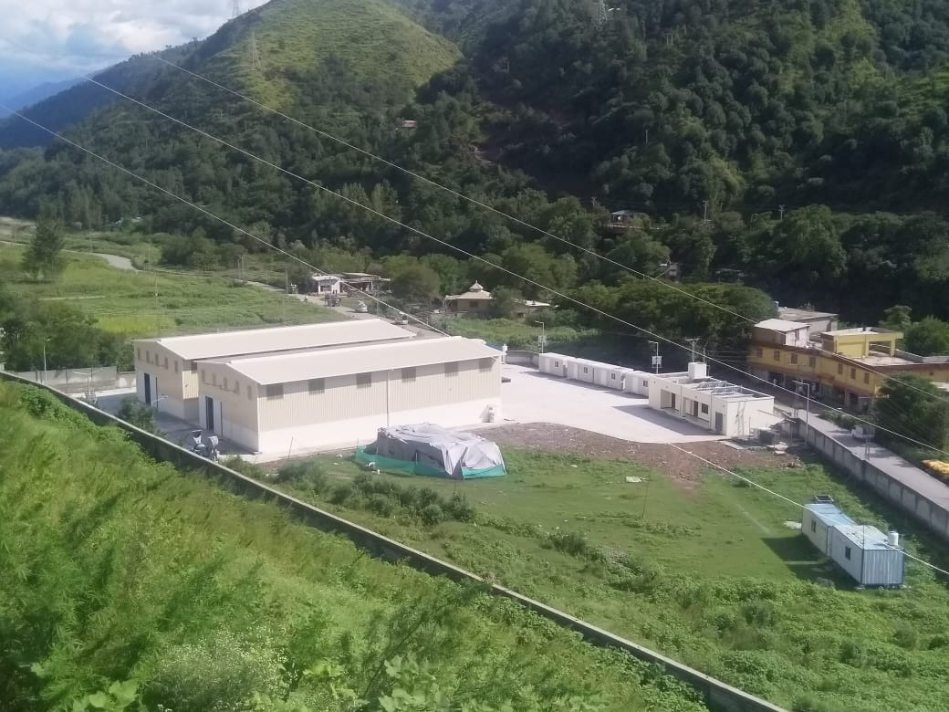
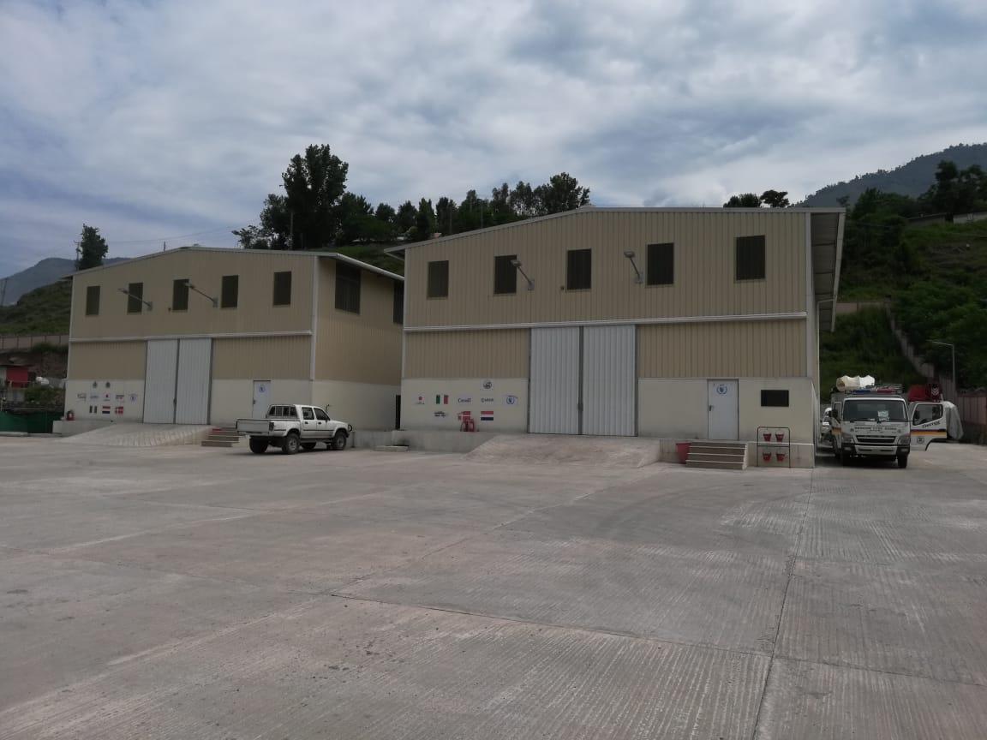
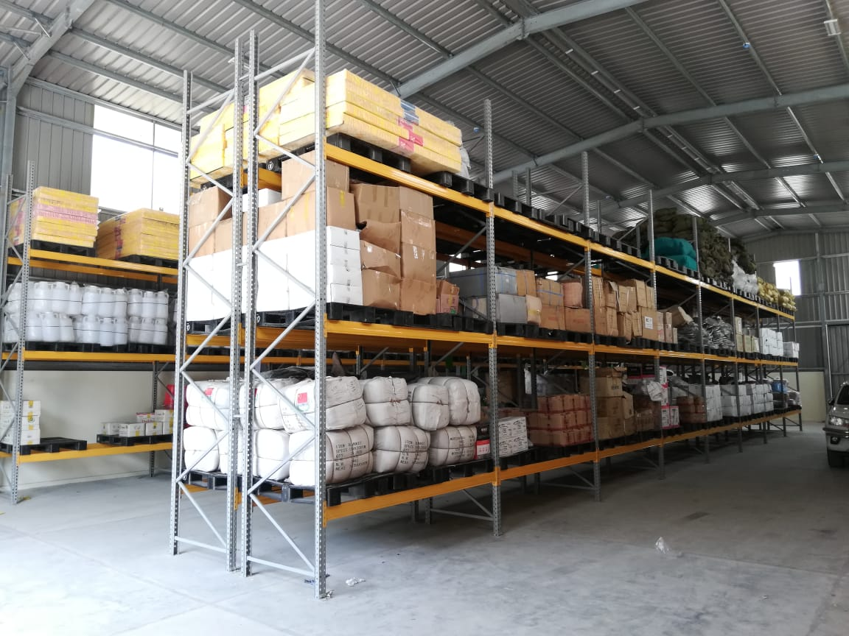
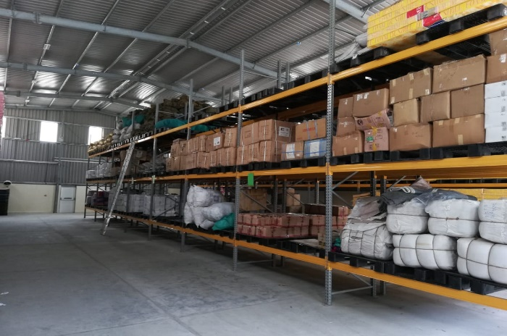
Preparedness
Logistic Arrangement
Humanitarian Response Facility ( HRF)

Slide 27
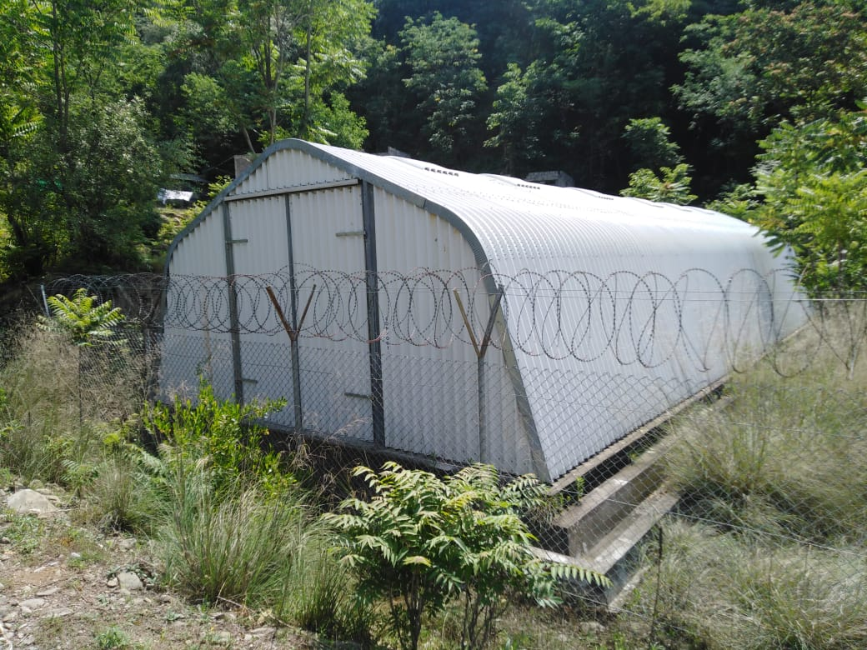
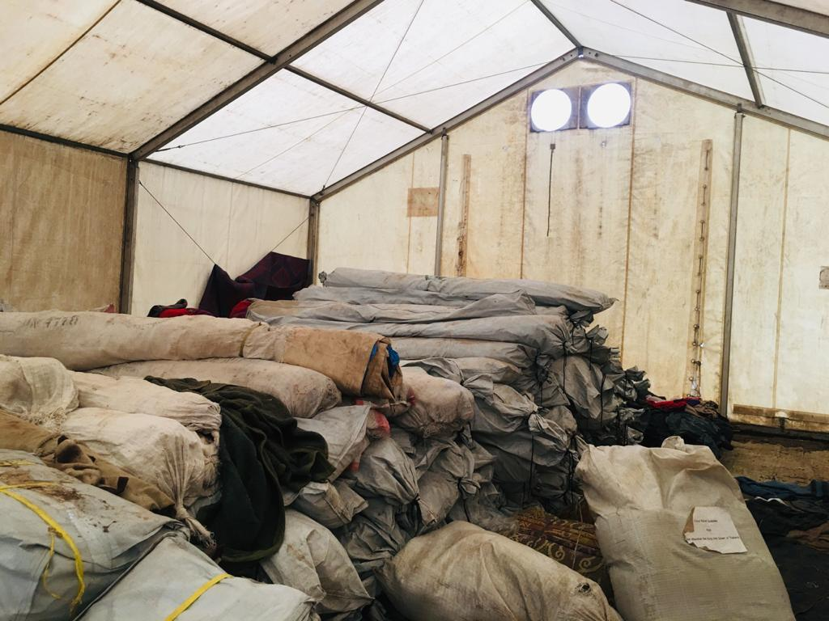
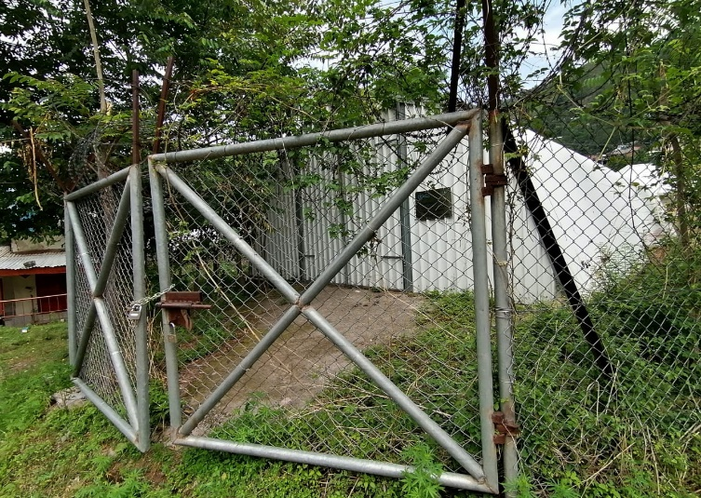
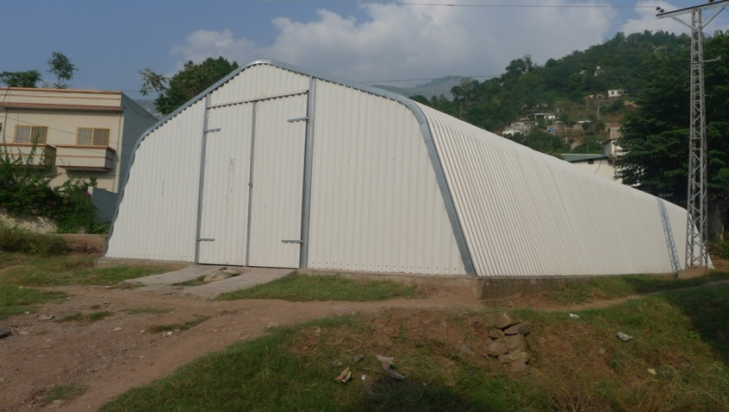
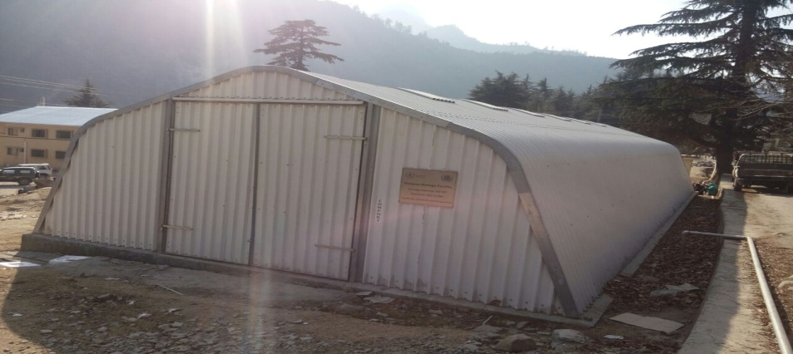
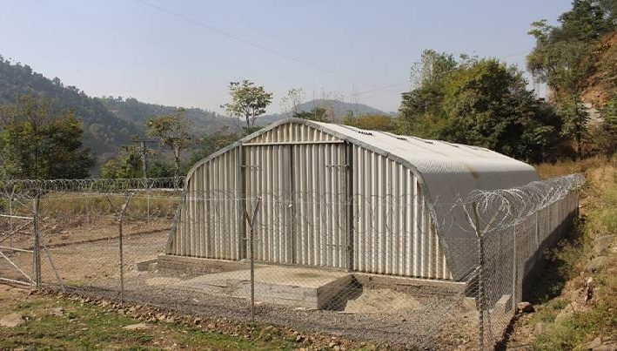
Preparedness
Logistic Arrangement
DDMAs Warehouse (All Districts)
Neelum

Slide 28
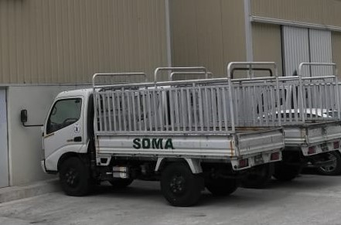
Preparedness
Logistic Arrangement
Trucks (Fleet of Five (05) mini trucks with courtesy of WFP)
Neelum

Slide 29
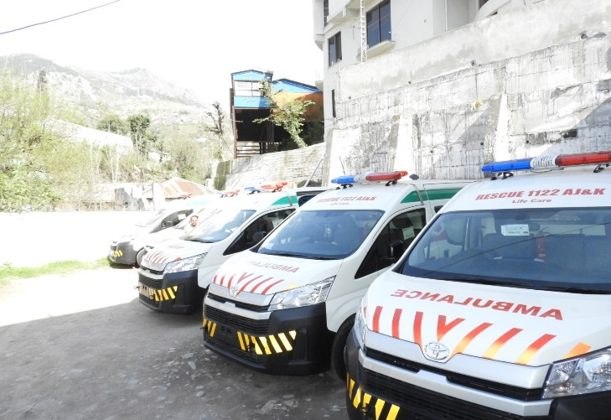
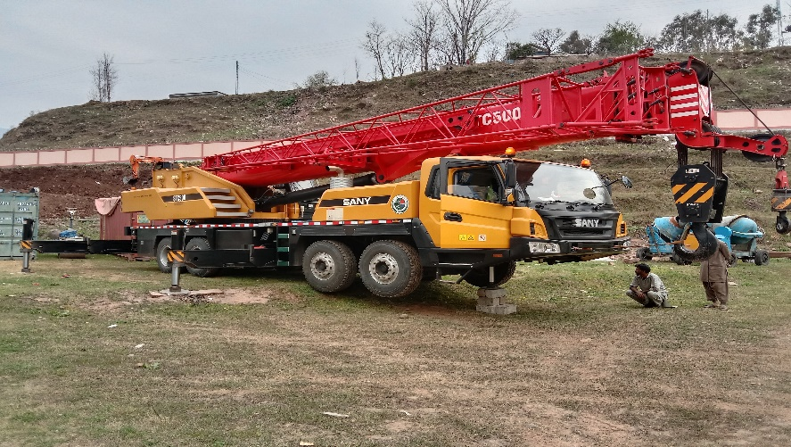
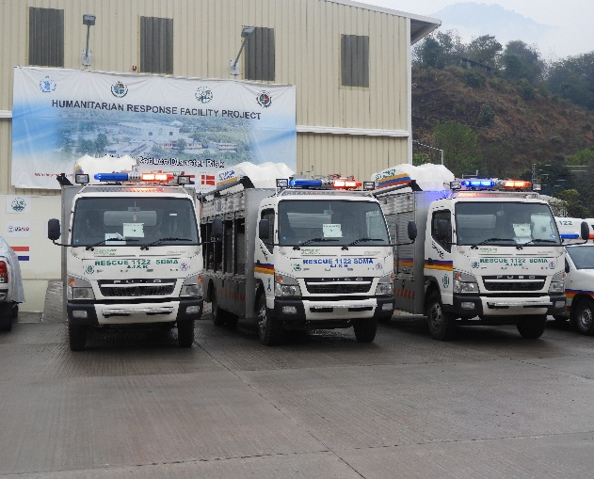
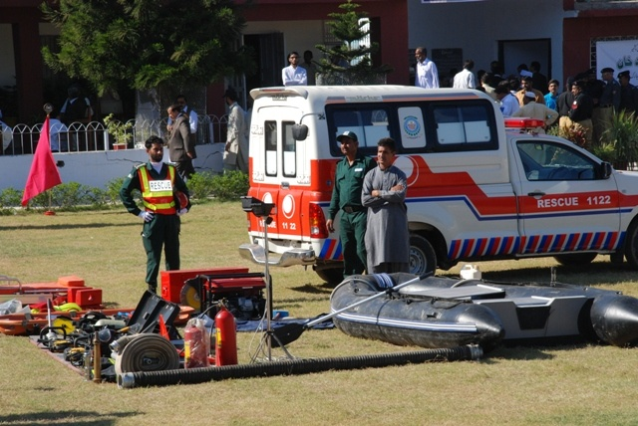
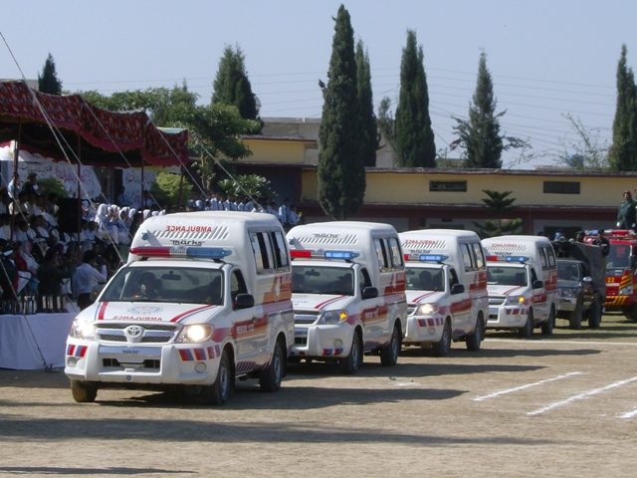
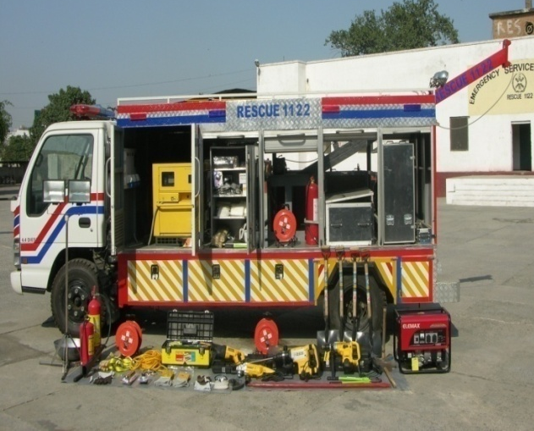
Resources with Rescue 1122
Ambulance | Fire Truck | Water Bowser | DR Vehicle | Recovery Vehicle | Cranes
13 | 5 | 1 | 6 | 1 | 3

Slide 30
Health Facilities with Bed Strength in AJK
Muzaffarabad Division
Institution | No of Beds
CMH | 250
AIMS | 300
THQ Hattian | 50
Neelum Hosp | 60
THQ Kel | 30
MDF Jumber | 50
Total MZD Div | 740
Mirpur Division
Div Hospital Mirpur | 400
THQ Dudyal | 100
New Mirpur City | 100
DHQ Hospital Kotli | 230
THQ Sehansa | 50
THQ Nikyal | 50
THQ khoi Ratta | 30
THQ Charhoi | 50
DHQ Hosp. Bhim | 150
THQ Hosp. BurNala | 50
Total Mirpur Div | 1210
Poonch Division
CMH Rawlakot | 250
THQ Hajeera | 50
DHQ Bagh | 150
CDH Hill | 50
THQ dhirkot | 50
DHQ Pallandri | 100
Civ. Hospital Trarkhal | 20
THQH Kahuta (Haveli) | 50
Total Poonch Div | 720
Grand Total | 2670

Slide 31
Preparedness – Available Stocks with SDMA (NFIs)
Sr. No | Item | Qty
01 | Mattress | 509
02 | Winterized Tent | 67
02 | V-Tent | 185
03 | Foam Seat 3x3 | 43
04 | Sleeping Bags | 1121
05 | Plastic Mats (Different Size) | 1307
06 | Plastics Sheets | 821
07 | Blanket | 289
08 | Quilts | 241
09 | Ladies Shawl | 273
10 | Generator | 79
11 | Water Filtration Plant | 07

Slide 32
District Wise State of Relief
District | Tents | Water Filter | Plastic Sheets | Plastic Mats | Blankets | Shawls | Shelter Box | Sleeping Bag | Mattress
Poonch | Nil | Nil | Nil | Nil | Nil | Nil | Nil | Nil | Nil
Bagh | Nil | Nil | Nil | Nil | Nil | Nil | Nil | Nil | Nil
Bhimber | 110 | Nil | 4 | 170 | 40 | Nil | Nil | 10 | 20
MZD | DDMA Muzaffarabad associated with SDMA Warehouse
Jehlum Valley | 08 | Nil | Nil | Nil | Nil | 05 | Nil | 7 | 04
Neelum | Nil | Nil | Nil | Nil | Nil | Nil | Nil | Nil | Nil
Sudhnuti | 05 | 05 | Nil | 18 | Nil | 12 | 01 | Nil | Nil
Kotli | 269 | Nil | 134 | 138 | 25 | 180 | Nil | 50 | Nil
Mirpur | Nil | Nil | Nil | Nil | Nil | Nil | Nil | Nil | Nil
Haveli | 15 | Nil | 03 | 08 | 100 | 150 | Nil | Nil | Nil

Slide 33
Preparedness
Available Machinery
Items | Mzd | Jhelum Valley | Bhimber | Sudhnuti | Haveli | Rw.kot | Bagh | Neelum | Kotli | Mirpur | Total
Crane | 1 | 0 | 0 | 0 | 0 | 1 | 0 | 0 | 0 | 1 | 3
Crawler Dozer | 5 | 2 | 1 | 2 | 2 | 3 | 1 | 2 | 0 | 0 | 18
Wheel Loader | 3 | 1 | 1 | 3 | 2 | 4 | 2 | 2 | 2 | 2 | 22
Excavator | 3 | 1 | 0 | 0 | 1 | 2 | 1 | 2 | 1 | 1 | 12
Dump Truck | 3 | 1 | 0 | 1 | 1 | 4 | 1 | 4 | 1 | 2 | 18
Uni-mog Trailer | 0 | 0 | 2 | 0 | 0 | 0 | 3 | 0 | 2 | 0 | 7
Ambulance | 18 | 9 | 56 | 1 | 5 | 11 |  | 18 | 55 | 10 | 183
Fire Tender | 5 | 1 | 0 | 2 | 1 | 2 | 1 | 1 | 2 | 3 | 18
Boats with OBM | 3 | 0 | 0 | 0 | 0 | 0 | 0 | 0 | 0 | 1 | 4
Disaster Rescue Vehicle | 1 | 0 | 0 | 2 | 1 | 1 | 1 | 1 | 1 | 1 | 9

Slide 34
Stock Position of Food Department
Name of Station | Wheat Balance (in tons)
Base Godown Islamabad | 1062
UK Mills Rawat | 387
Mangla Flour Mills Mirpur | 318
N. Fine Flour Mills Mirpur | 35
Pak Kashmir Flour Mills Dudyal | 201
Saddique Flour Mills Jatlan | 430
Total | 2433
K.U Flour Mills Sahala | 19
Neelum Flour Mills Mzd | 314
Gillani Flour Mills Kohala | 99
Jadded Flour Mills Gorah | 12
Sadozai F.M.A Patan | 98
Itfaq Flour Mills Sensa | 116
Total | 658
G.Total | 3091
Utility Stores has shared its storage status and network in AJK

Slide 35
Food Items Required
Sr# | District | Relief Caseload | Food(MTs) for 3 months
1 | Muzaffarabad | 3630 | 1463.6
2 | Jehlum Valley | 1505 | 606.8
3 | Neelum | 2078 | 837.8
4 | Rawalakot | 1127 | 454.4
5 | Bagh | 1500 | 604.8
6 | Haveli | 1570 | 633.0
7 | Sudhnoti | 250 | 100.8
8 | Mirpur | 500 | 201.6
9 | Bhimber | 1640 | 661.2
10 | Kotli | 545 | 219.7
Total |  | 14345 | 5783.9

Slide 36
District Wise Requirement of Non Food Items
District | Tents | Mattress | T.Sheets | Plastic Mats | Blanket | Kitchen set | Hygiene Kits | Sleeping Bags
Muzaffarabad | 7260 | 7260 | 10890 | 7260 | 10980 | 3630 | 3630 | 10890
Jhelum Valley | 300 | 150 | 300 | 0 | 300 | 150 | 100 | 100
Neelum | 2500 | 8000 | 0 | 2500 | 8000 | 2500 | 2500 | 0
Rawalakot | 3000 | 7000 | 3000 | 2000 | 7000 | 3000 | 3000 | 0
Bagh | 2000 | 6000 | 3000 | 2000 | 6000 | 1700 | 7500 | 0
Haveli | 2000 | 6500 | 0 | 2000 | 6000 | 2000 | 2000 | 0
Sudhnoti | 200 | 200 | 0 | 200 | 500 | 300 | 500 | 0
Mirpur | 800 | 1600 | 1000 | 0 | 1600 | 0 | 0 | 500
Bhimber | 2000 | 5000 | 2000 | 2000 | 6000 | 2000 | 2000 | 0
Kotli | 0 | 1000 | 100 | 0 | 200 | 100 | 100 | 0
Total | 20060 | 42710 | 20290 | 17960 | 46580 | 15380 | 21330 | 11490

Slide 37
Gaps/Additional Requirements
NDMA has been requested to bridge the gap for provision of NFIs
Arrangement for NFIs & FIs as per caseload
NHA needs to setup well equipped road clearing units between Kohala to Chakothi and other roads under its operation and control
Provision of Water Rescue Equipment

Slide 38
Details of EOCs Established
Department | Focal Person | Emergency Control Room No
SDMA Muzaffarabad | Moazzam Zafar | 05822-921643
SDMA Muzaffarabad | Syed Shahid Akbar | 05822-921643
DDMA Muzaffarabad | Umar Qureshi | 052822-920055, 03460266956
DDMA Neelum | Akhtar Ayub | 05821-920001, 0355-8126666
DDMA Rawalakot | Rubiya Kanwal | 05824-920052, 0348-5524670
DDMA Bagh | Waqas Saleem | 05823-920046, 0342-8909449
DDMA Haveli | Zaheer Khan | 05823-921708, 0333-5506612
DDMA Sudhnoti | Sania Qamar | 05825-920011, 0310-9185530
DDMA Mirpur | Syed Zain | 05827-921270
DDMA Bhimber | Mubashir Mushtaq | 05828-920220, 0343-7707523
DDMA Jehlum Valley | Naqash Mushtaq | 05822-922607, 0312-9033868
DDMA Kotli | Shariq Talat | 05826-920164, 0307-5533133

Slide 39
THANK YOU
Designed & Developed by Syed I. Kazmi (UNDP/NDMA Coordination Officer for SDMA)

Slide 40
Utility Stores Storage Status and Network in AJK
District | S No. | Name of Stores | Location | Capacity
Muzaffarabad | 01 | MZD-76 | US Gharipan | 418 Sqft
 | 02 | MZD-79 | US Jalalabad | 630 Sqft
 | 03 | MZD-29 | US Gojra | 840 Sqft
 | 04 | MZD-19 | US Noluchi | 290 Sqft
 | 05 | MZD-47 | US Ambor | 528 Sqft
 | 06 | MZD-08 | US Rarra | 432 Sqft
 | 07 | MZD-80 | US Kulian | 320 Sqft
 | 08 | MZD-42 | US Lower Chatter | 418 Sqft
 | 09 | MZD-65 | H/S Upper Chatter | 828 Sqft
 | 10 | MZD-20 | Upper Chatter | 420 Sqft
 | 11 | MZD-21 | US Tariqbad | 400 Sqft
 | 12 | MZD-05 | US Airport | 672 Sqft
 | 13 | MZD-16 | US Manakpayan | 430 Sqft
 | 14 | MZD-10 | US Civil Sectrate | 876 Sqft
 | 15 | MZD-63 | US New Bustand | 800 Sqft
 | 16 | MZD-77 | US Sama Bandi | 450 Sqft
 | 17 | MZD-15 | US Chellah | 1480 Sqft
 | 18 | MZD-09 | US Palate | 930 Sqft
 | 19 | MZD-01 | US Bank Road | 2371 Sqft
 | 20 | MZD-23 | US Langarpura | 600 Sqft
 | 21 | MZD-02 | US Khwaja Bazaar | 744 Sqft
 | 22 | MZD-70 | Al-Qaim Plaza center plate | 688 Sqft
 | 23 | MZD-82 | US Tanga Stand | 385 Sqft
 | 24 | MZD-14 | US Kohri | 560 Sqft
 | 25 | MZD-07 | US Patikka | 1200 Sqft
 | 26 | MZD-06 | US Gari Duppata | 1200 Sqft
 | 27 | MZD-55 | US Collage Chowk | 600 Sqft
Back

Slide 41
Utility Stores Storage Status and Network in AJK
District | S No. | Name of Stores | Location | Capacity
Poonch | 28 | MZD-31 | US CMH Rawlakot near C.M.H | 550 Sqft
 | 29 | MZD-28 | US Main Bazar Rawlakot | 1085 Sqft
 | 30 | MZD-41 | US Paniullah | 350 Sqft
 | 31 | MZD-39 | US Datoot | 720 Sqft
 | 32 | MZD-81 | US Jandalla | 540 Sqft
 | 33 | MZD-56 | US Thorrat | 668 Sqft
 | 34 | MZD-60 | US Kud Bazar | 400 Sqft
 | 35 | MZD-38 | US Housing Scheme City | 620 Sqft
 | 36 | MZD-30 | US Khai Galla | 800 Sqft
 | 37 | MZD-50 | Khai Galla 2 | 440 Sqft
 | 38 | MZD-59 | US Hussain Kot | 544 Sqft
 | 39 | MZD-72 | US Chek Bazar | 490 Sqft
Bagh | 40 | MZD-25 | US Main Store Bagh City | 1530 Sqft
 | 41 | MZD-40 | US Maloot | 720 Sqft
 | 42 | MZD-45 | US Bergade | 850 Sqft
 | 43 | MZD-44 | US Water Supply | 675 Sqft
 | 44 | MZD-78 |  | 1800 Sqft
 | 45 | MZD-35 | US Rerra Bagh | 430 Sqft
 | 46 | MZD-36 | US Hari Gail | 600 Sqft
 | 47 | MZD-27 | US Dirkot | 945 Sqft
 | 48 | MZD-49 | Chamankot | 750 Sqft
 | 49 | MZD-26 | US Arja | 880 Sqft
Neelum | 50 | MZD-74 | US Barian | 900 Sqft
 | 51 | MZD-73 | US Jurra | 875 Sqft
 | 52 | MZD-18 | US Kundal Shai | 800 Sqft
 | 53 | MZD-34 | US Athmuqam | 330 Sqft
Hattian Bala | 54 | MZD-11 | US Chakar | 400 Sqft
 | 55 | MZD-66 | US Hattian Balla | 644 Sqft
 | 56 | MZD-24 | US Sain Bagh | 414 Sqft
 | 57 | MZD-62 | US Lamnian | 672 Sqft
 | 58 | MZD-87 | US Chennari | 546 Sqft
Back

