Slide 1


Preparatory Survey for the Project for Flood Management Enhancement in the Islamic Republic of Pakistan
EXPLANATION OF
DRAFT FINAL REPORT
June-July, 2024
JAPAN INTERNATIONAL COOPERATION AGENCY
(JICA)
CTI Engineering International Co., Ltd.
International Meteorological Consultant Inc.

Slide 2
Works of Preparatory Survey
Formulation of the Project to meet the conditions of the Japan’s Grant Aid
Stages of the Preparatory Survey;
- 1st stage: Field Survey (June and July, 2023)
- 2nd stage: Analysis in Japan
- 3rd stage: Field Survey (October and November, 2023)
- 4th stage: Analysis in Japan
- 5th stage: Explanation of a Draft Final Report to Pakistan (June, 2024)

Slide 3
Member of JICA Preparatory Survey Team
JICA Officials
Name | Designation | Affiliation
✓Taichi MINAMITANI | Leader | Director, DRR Group, Global Env. Dept.
✓Hikaru SAKAIDA | Project Coordinator | Deputy Director, DRR Group, Global Env. Dept.
Consultant Team
Name | Designation | Affiliation
✓Tsuyoshi MATSUSHITA | Chief Consultant / River Planning | CTII
River Structure (River Improvement)
✓Oki SHINDO | Deputy Chief Consultant / River Structure Design | CTII
Takashi ONO | Construction Plan / Cost Estimate | CTII
Taiga KATAOKA | Cost Estimate/ Construction Plan | CTII
Hydrological and Hydraulic Observation, Data Monitoring System
✓Yoshihisa UCHIDA | Hydrological and Hydraulic Observation | IMC
Takeshi MATSUMURA | Data Monitoring System | IMC
Kenji MORI | Equipment Procurement Plan / Cost Estimate | IMC
✓Yuta YAMAUCHI | Environmental and Social Considerations | CTII
CTII: CTI Engineering International Co., Ltd. IMC: International Meteorological Consultant Inc.
Notes:
Hydrological and hydraulic observation instruments
Data monitoring system

Slide 4
Contents of the Project:
I. Procurement of Equipment
[Hydrological and Hydraulic Observation Network]
Water level gauges, flow meters and rain gauges: 45 locations
[Data Monitoring System]
Communication equipment for the transmission of observation data from hydrological and hydraulic observation instruments to the central data management center
Two central data management centers (Planned location: Lahore (WAPDA), Islamabad(FFC))
II. Construction of Facility
[River Structure (River Improvement)]
Rehabilitation of river structure which was damaged by 2022 flood
Notes:
Hydrological and hydraulic observation network
Data Monitoring System

Slide 5
III. Consulting Services, Soft Components
III-1: Consulting Services
Detailed design, bidding assistance, procurement supervision
III-2: Soft Components
Technical support for the operation and maintenance of hydrological and hydraulic observation equipment and data monitoring systems

Slide 6
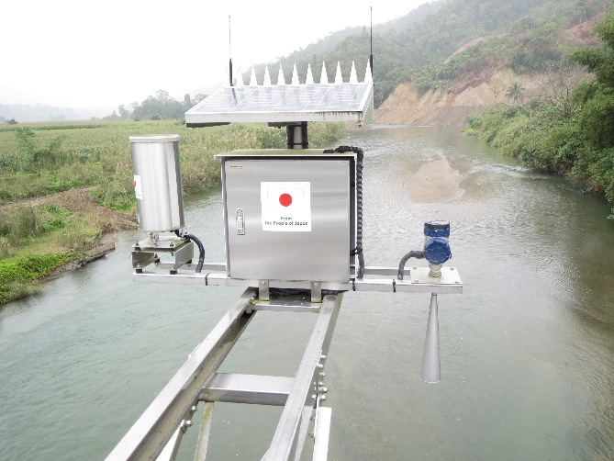
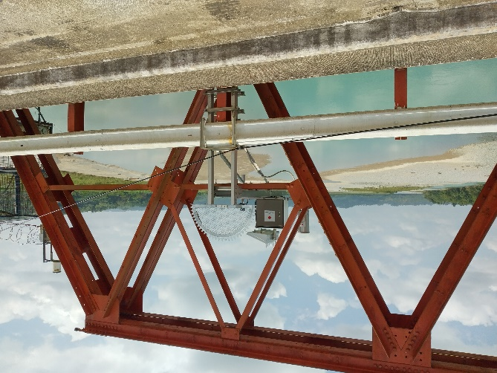
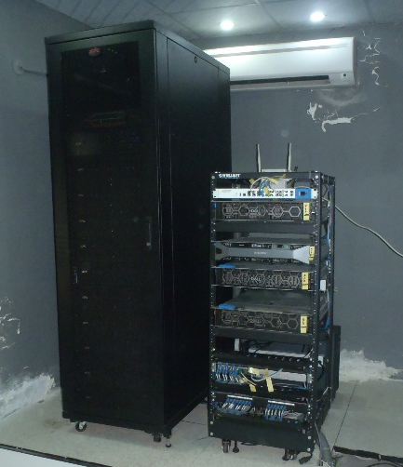
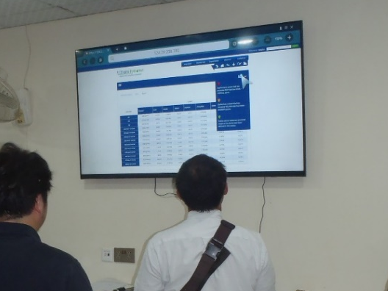
Design Policy on Hydrological and Hydraulic Observation Network
I. Procurement of Equipment
Gauges (water level, flow velocity, rain): 45 location (46 gauge)
[Data Monitoring System]
Data Transmission:
Mobile phone network
Data Management Center:
Two
in Lahore (WAPDA), Islamabad(FFC)

Slide 7
I. Procurement of Equipment
Hydrological and Hydraulic Equipment Determined
from the Preparatory Survey
 | Items | FFC | WAPDA Town | NDMA | PMD FFD | PCIW | PID | IRSA | WAPDA House | HHOS Sites (45)
Equipment for the Central Data Management Centres
 | Data Receiving System | 1 | 1
 | Data Processing System | 1 | 1
 | Database System | 1 | 1
 | Information Provision System | 1 | 1
 | Data Management System |  | 1
 | Alert System |  |  |  |  |  |  |  | 1
Data Display System |  | 3 |  | 1 | 1 | 1 | 4 | 1 | 1
Hydrological & Hydraulic Observation System |  |  |  |  |  |  |  |  |  | 46
Acoustic Doppler Current Profiler (ADCP) |  | 1 | 5
Automatic Weather Observation System |  |  |  |  | 5
FFC: Federal Flood Commission WAPDA: Water & Power Development Authority NDMA: National Disaster Management Authority IRSA: Indus River System Authority PMD: Pakistan Meteorological Department (FFD: Flood Forecasting Division) PCIW: Pakistan Commissioner for Indus Waters PID: Provincial Irrigation Department HHOS: Hydrological & Hydraulic Observation System

Slide 8
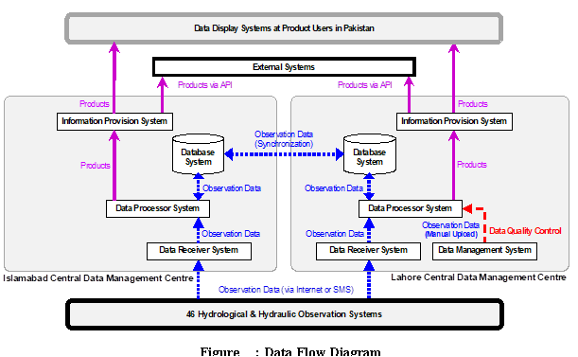
I. Procurement of Equipment
        Data Flow of Hydrological & Hydraulic
        Observation Network

Slide 9
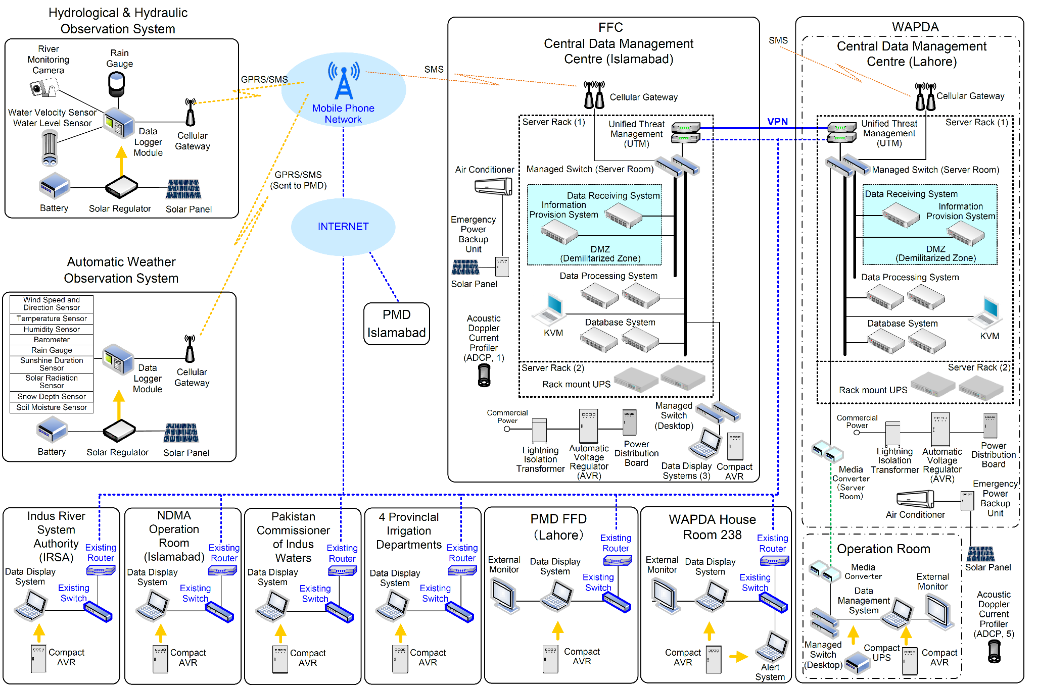
I. Procurement of Equipment

Slide 10
I. Procurement of Equipment
Automatic Observation Elements and Outputs
Observation Element | Output
Wind Speed & Direction | Wind Speed and Direction Sensor | Instantaneous value (1 minute average as per WMO) 2-minute speed and direction average 10-minute speed and direction average Minimum and maximum daily wind speed instantaneous values
Temperature | Temperature Sensor | Instantaneous value (1 minute average as per WMO) Dew point (calculated from most recent "instantaneous" value for temperature and humidity) Minimum and maximum daily instantaneous values
Humidity | Humidity Sensor | Instantaneous humidity value (1 minute average as per WMO) Minimum and maximum daily instantaneous values
Pressure | Barometer | Instantaneous averaged value (1 minute average as per WMO) Pressure adjusted for mean sea level Minimum and maximum daily instantaneous values
Precipitation | Rain Gauge (Sensitivity: 0.5mm) | Latest measured value (Typically total for the last hour) Daily total
Sunshine Duration | Sunshine Duration Sensor | Latest measured value (total minutes of sunshine since last measurement) Daily total
Solar Radiation | Solar Radiation Sensor | Latest measured value since the last measurement Daily total
Snow | Snow Depth Sensor | Latest measured value
Soil Moisture (5cm, 10cm, 20cm, 30cm, 50cm, 100cm) | Soil Moisture Sensor | Latest measured value Daily minimum and maximum values
Note: According to the WMO the Instantaneous value should actually be a short term average as per Manual 8: Guide to Meteorological Instruments and Methods of Observation. Instantaneous: in order to exclude natural small-scale variability and noise, an average value over a period of 1 min is considered as a minimum and is most suitable.

Slide 11
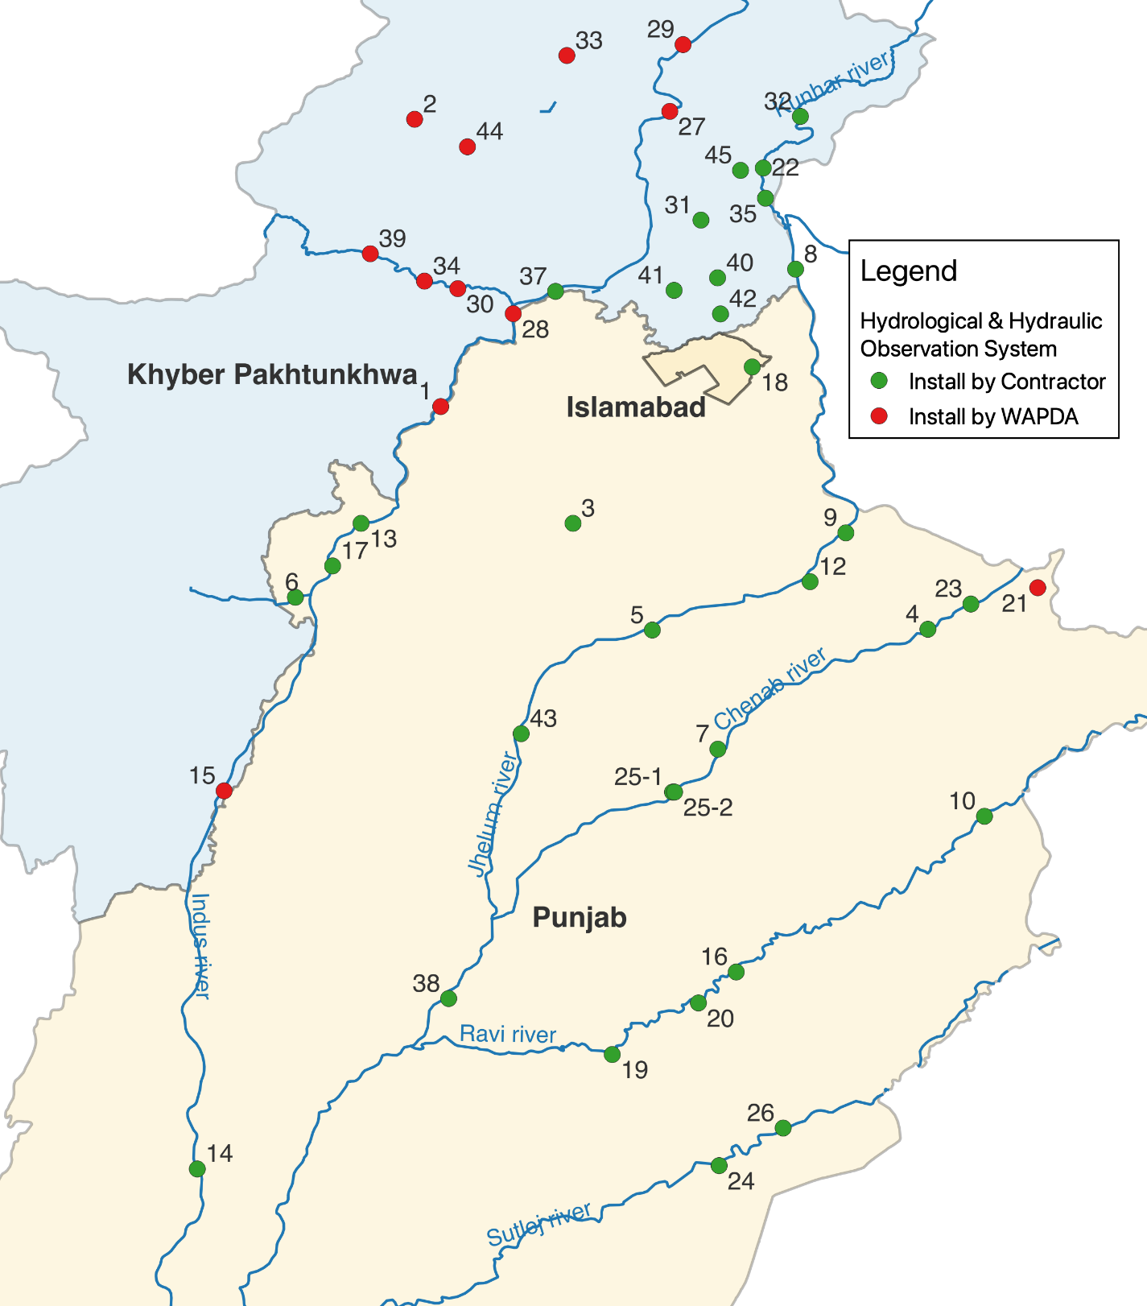
Location of Hydrological and Hydraulic Observation,
Data Monitoring System
I. Procurement of Equipment
Legend
Hydrological & Hydrological Observation System
: Sites not located in the restricted travel area specified by the Government of Japan
: Sites located in the restricted travel area specified by the Government of Japan

Slide 12
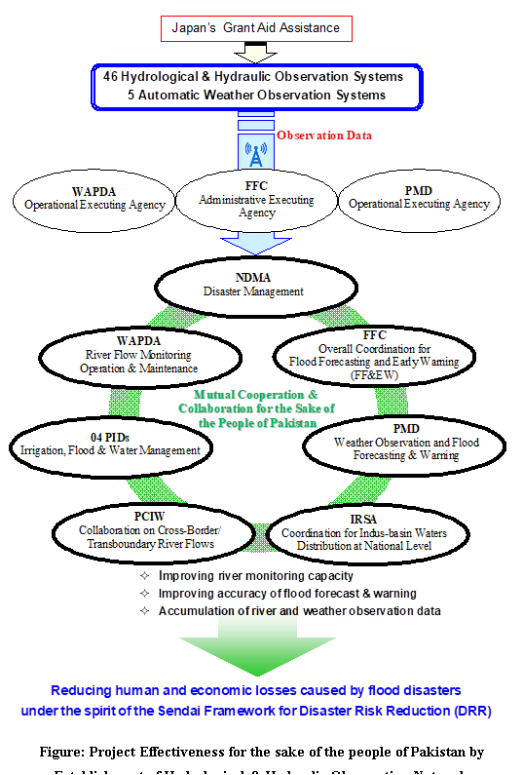
Project Effectiveness for the sake of the people of Pakistan by Establishment of Hydrological & Hydraulic Observation Network
I. Procurement of Equipment

Slide 13
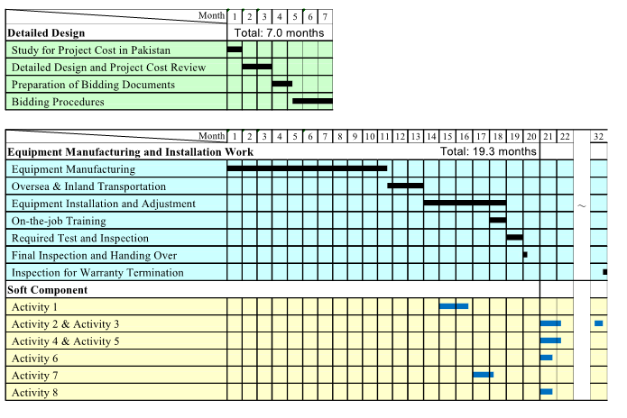
Schedule of Procurement of Hydrological and Hydraulic Observation Network, and Data Monitoring System
I. Procurement of Equipment

Slide 14
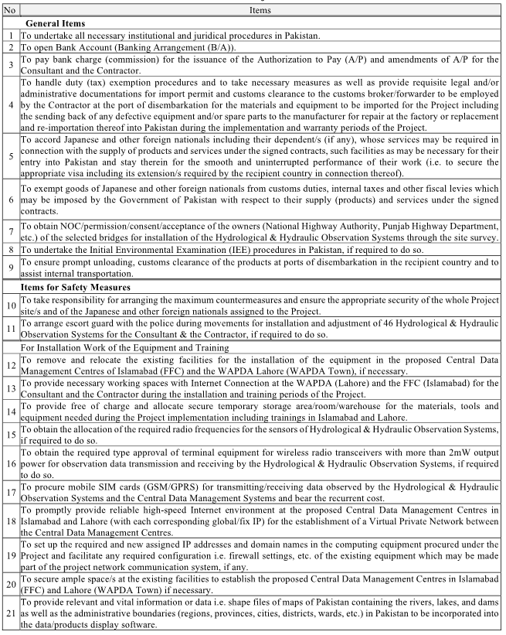
Undertakings by Pakistan Side (1/3)
I. Procurement of Equipment

Slide 15
Undertakings by Pakistan Side (2/3)
I. Procurement of Equipment

Slide 16
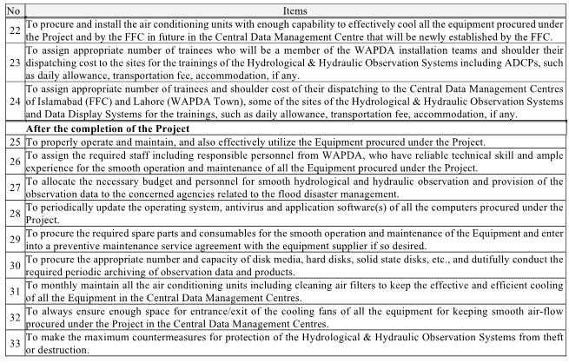
Undertakings by Pakistan Side (3/3)
I. Procurement of Equipment

Slide 17
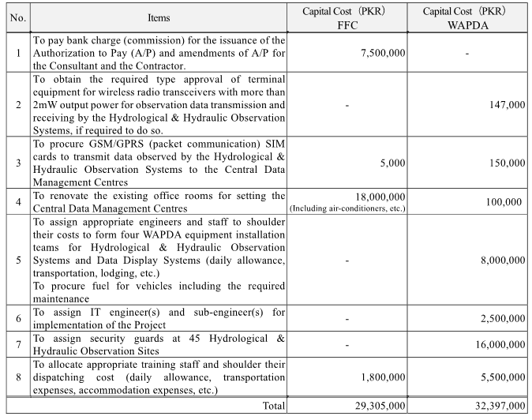
Estimated Initial Cost by FFC &WAPDA
I. Procurement of Equipment

Slide 18
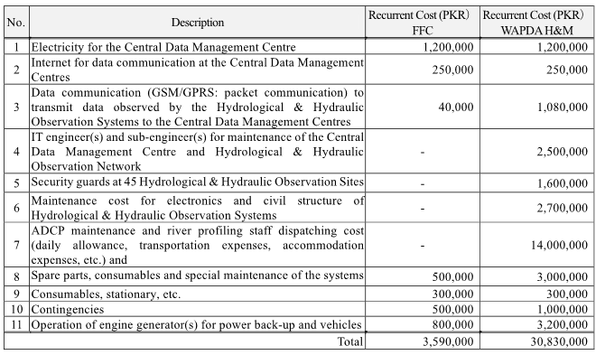
Estimated O&M Cost by FFC &WAPDA
I. Procurement of Equipment

Slide 19
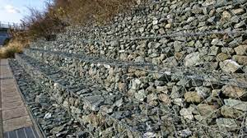
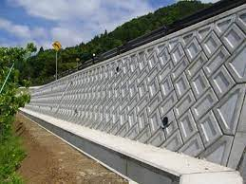
Design Policy on River Improvement
(Construction of River Structure)
II. Construction of Facility
External force (Scale of flood) for designing of flood control structure
→PC-1 in 2022 (More than 2022 flood)
To enhance safety level against flood by adopting more durable structures (following the “Build Back Better” principle)
Improvement
Gabion Revetment
Concrete Revetment
Reference case in Japan

Slide 20
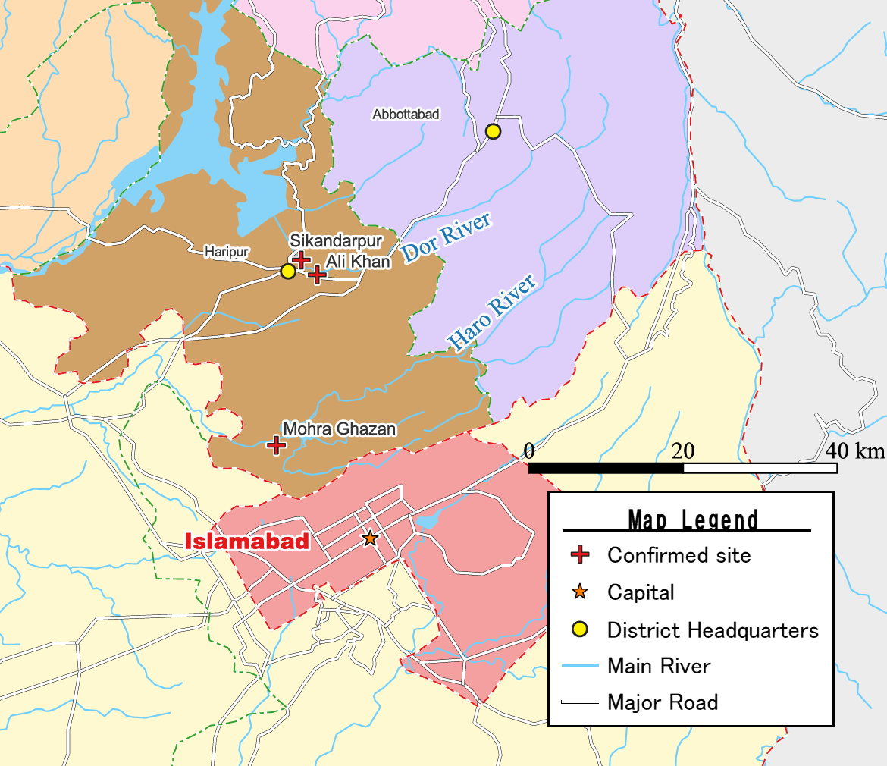
Project Area of River Improvement (Construction of River Structure)
II. Construction of Facility
About 80 damaged flood management structures (total length approx.20km) were reported after 2022 Flood.
Three Sites were selected as the target sites of Japan’s Grant Aid Project, based on the result of field survey and discussions between JICA survey team and Pakistan side.
Selected Sites:
Mohra Ghazan, Ali Khan, Sikandarpur

Slide 21
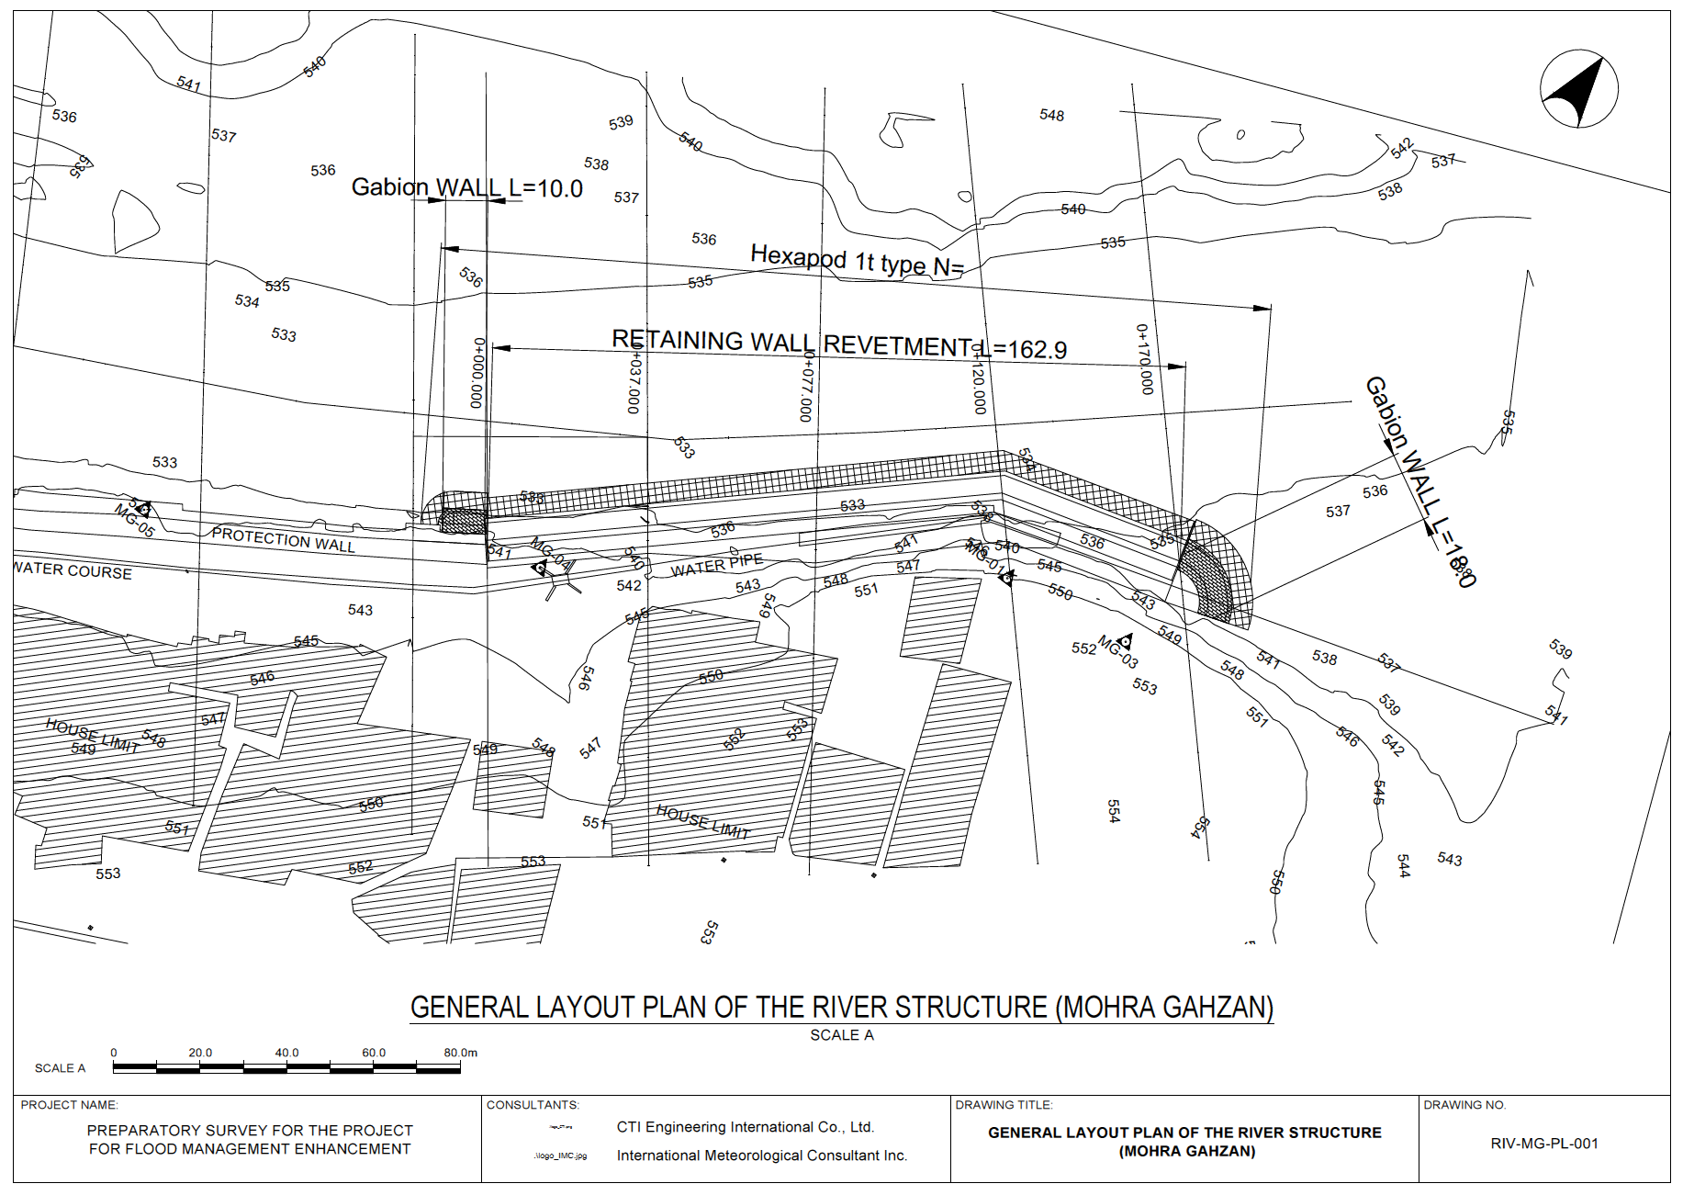
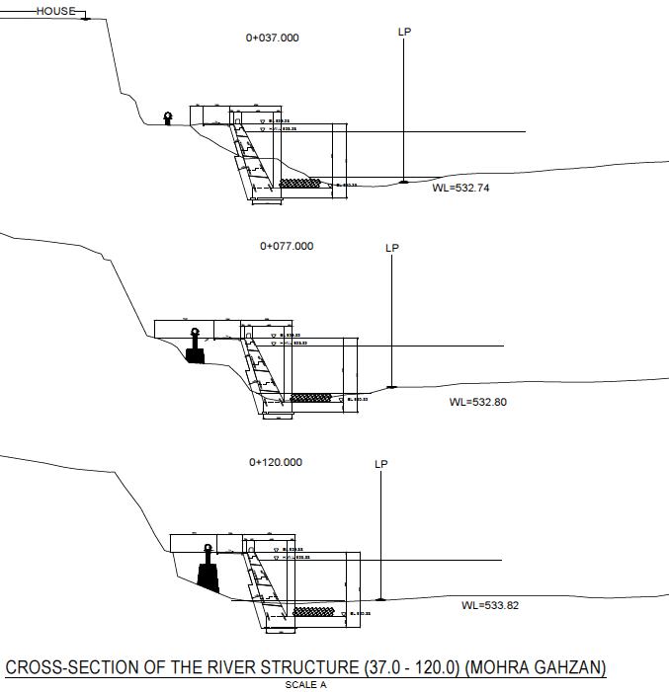
1. Mohra Ghazan
II. Construction of Facility
Scope of the Work:
Construction of Concrete Revetment (Height:8.0m, Length:163m)
To protect left bank
FLOW

Slide 22
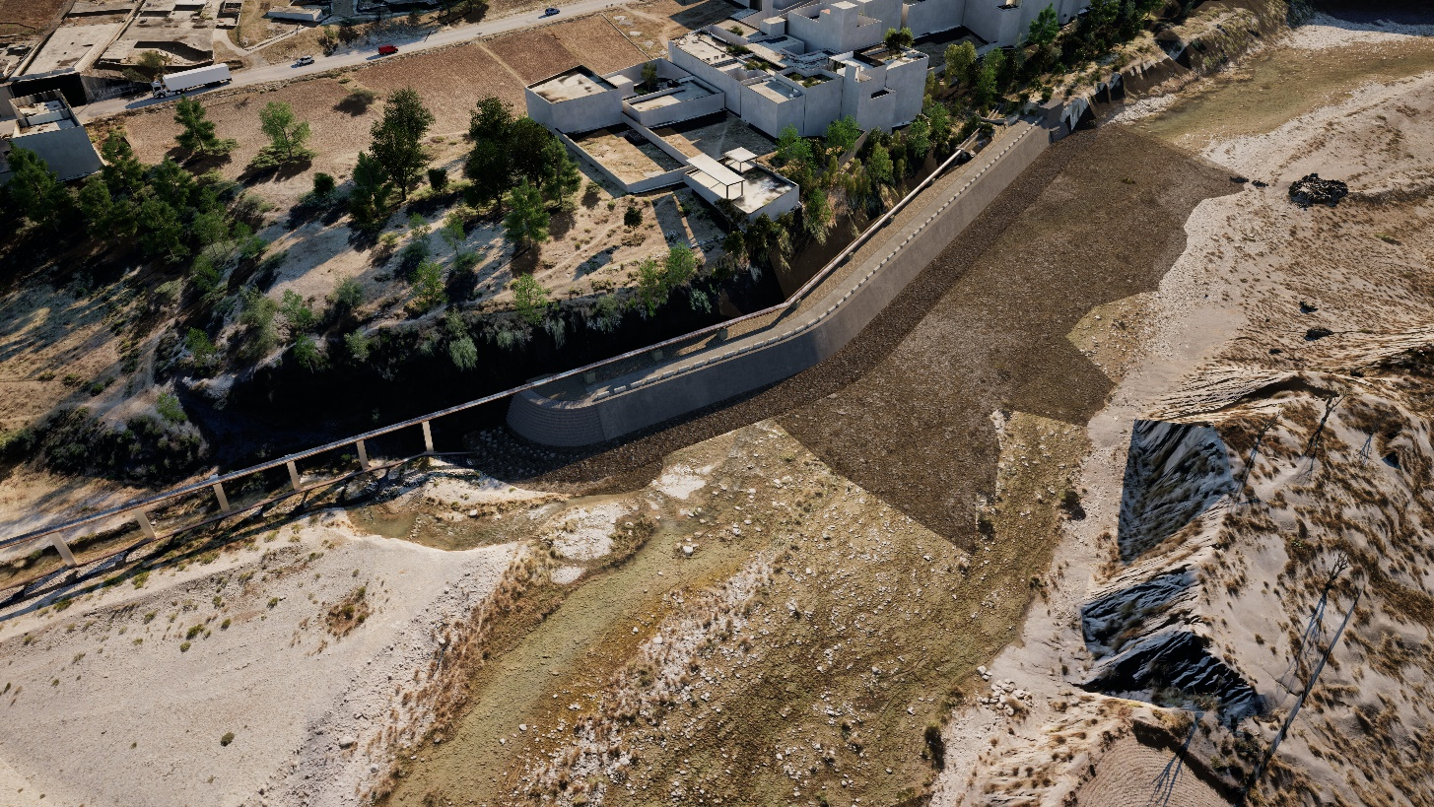
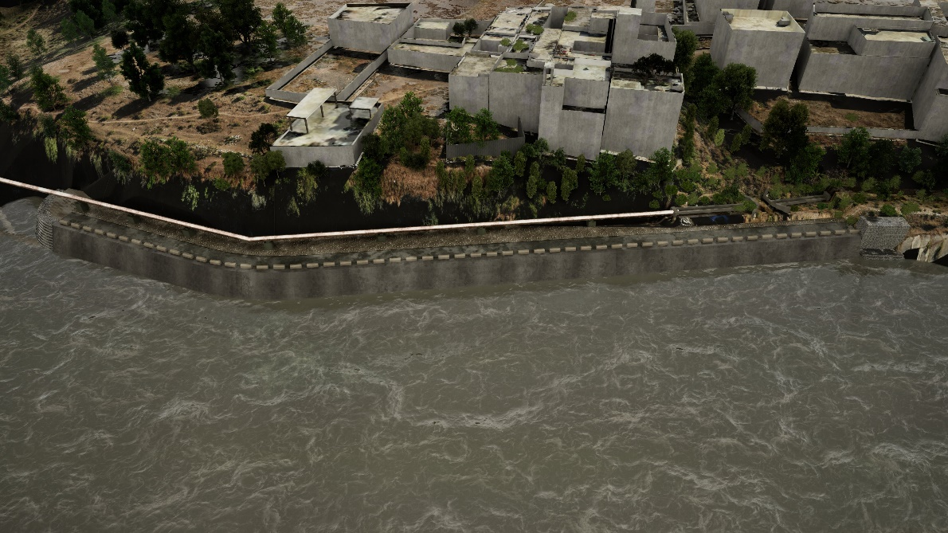
3D Image of Concrete Revetment in Mohra Ghazan
(Height:8.0m, Length:163m)
II. Construction of Facility
FLOW
Normal Condition
FLOW
Flood Condition
Notes:
For other sections, the design is progressing well. Revetment and Foot Protection Concrete block have been Designed.

Slide 23
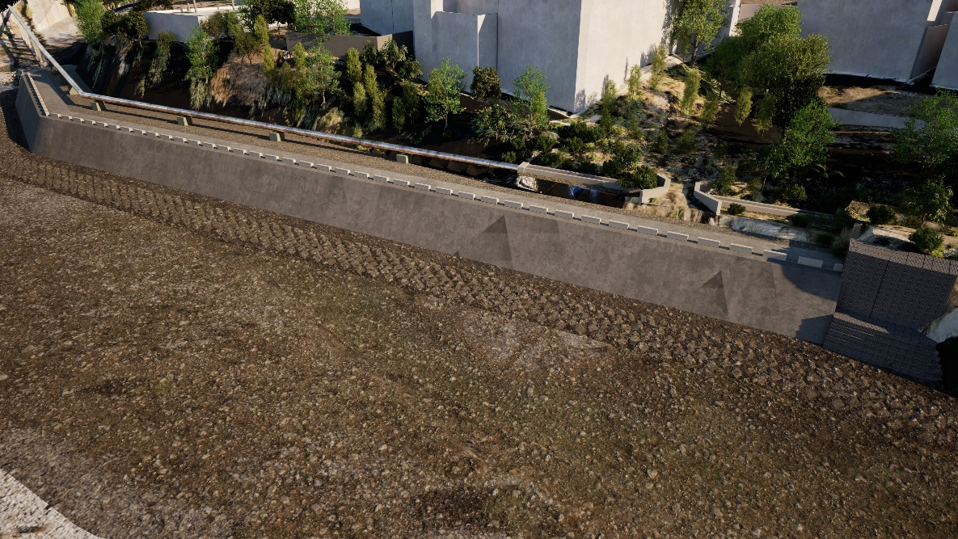
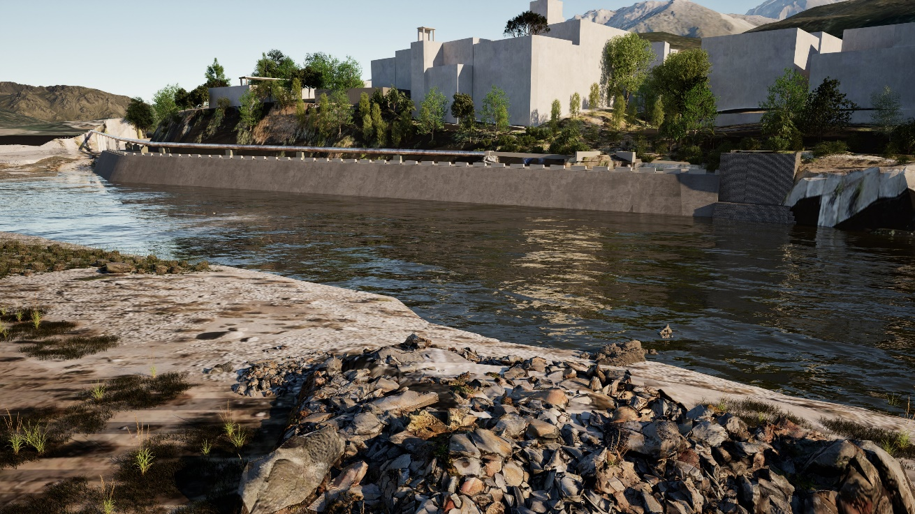
3D Image of Concrete Revetment in Mohra Ghazan
(Height:8.0m, Length:163m)
II. Construction of Facility
FLOW
Normal Condition
FLOW
Flood Condition

Slide 24
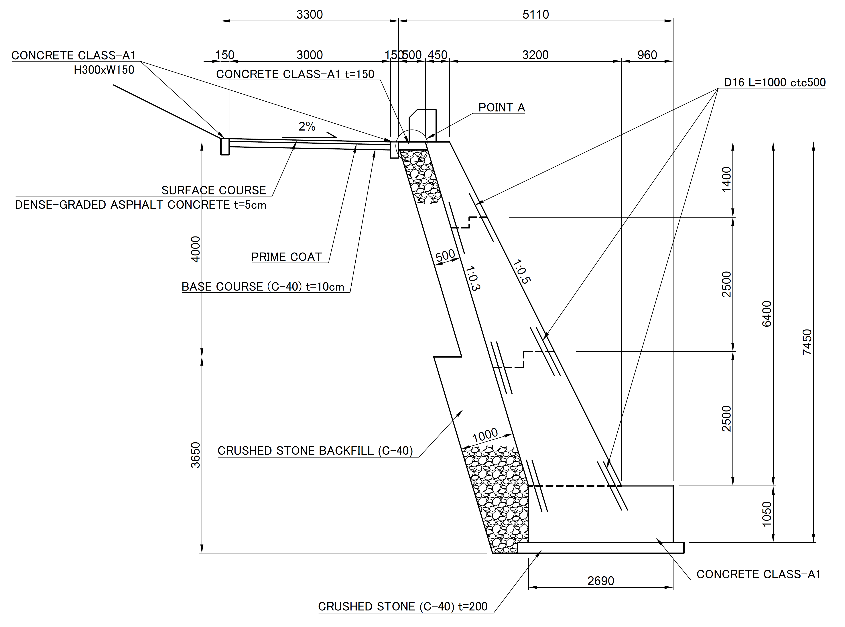
II. Construction of Facility
2. Ali Khan
Scope of the Work:
Construction of Concrete Revetment (Height:6.4m, Length:287m)
To protect left bank
FLOW

Slide 25
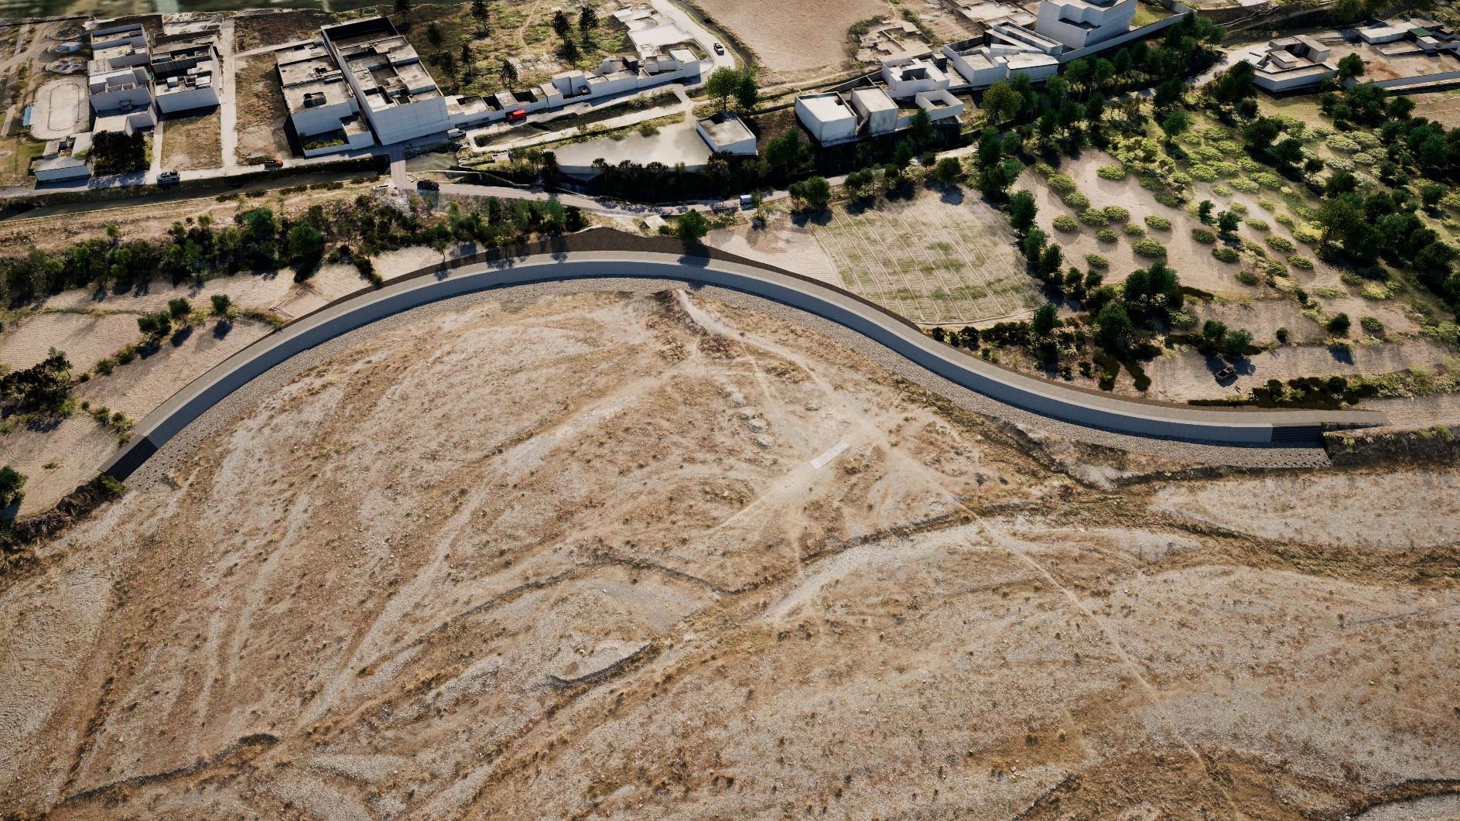
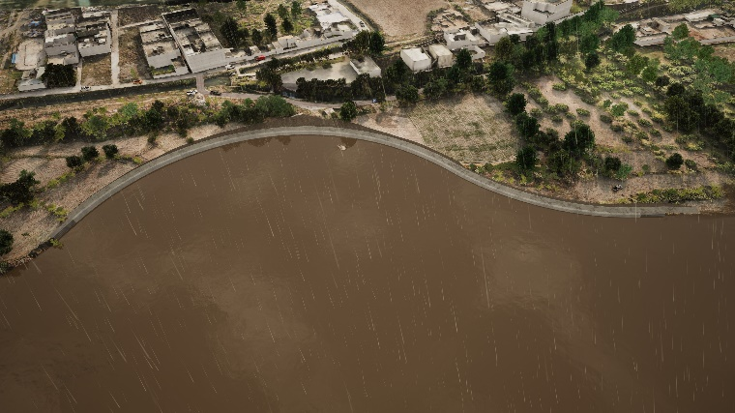
3D Image of Concrete Revetment in Ali Khan
(Height:6.4m, Length:287m)
II. Construction of Facility
FLOW
Normal Condition
FLOW
During Flood

Slide 26
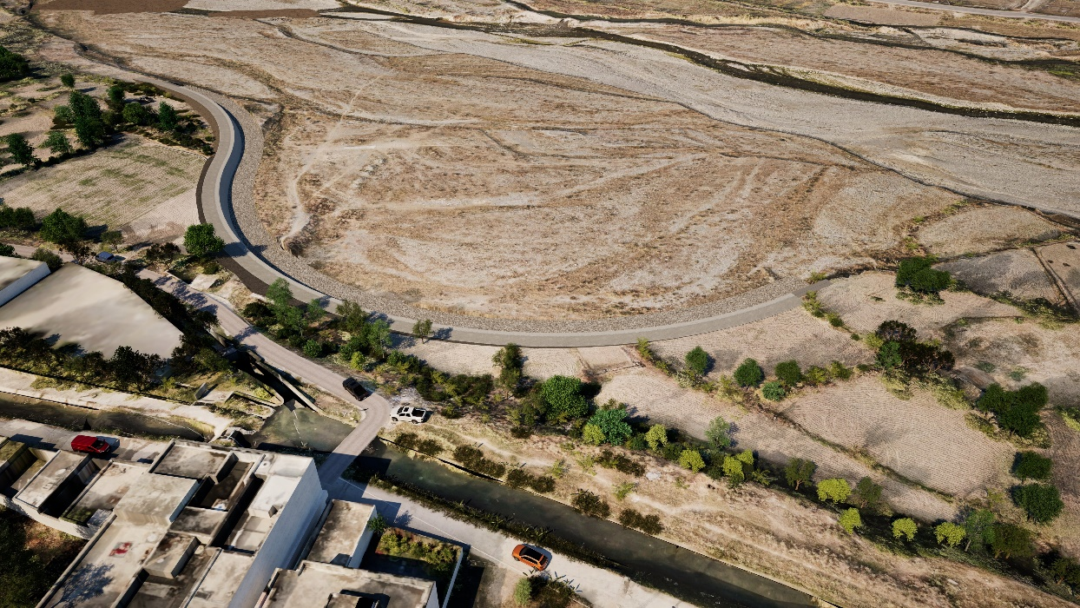
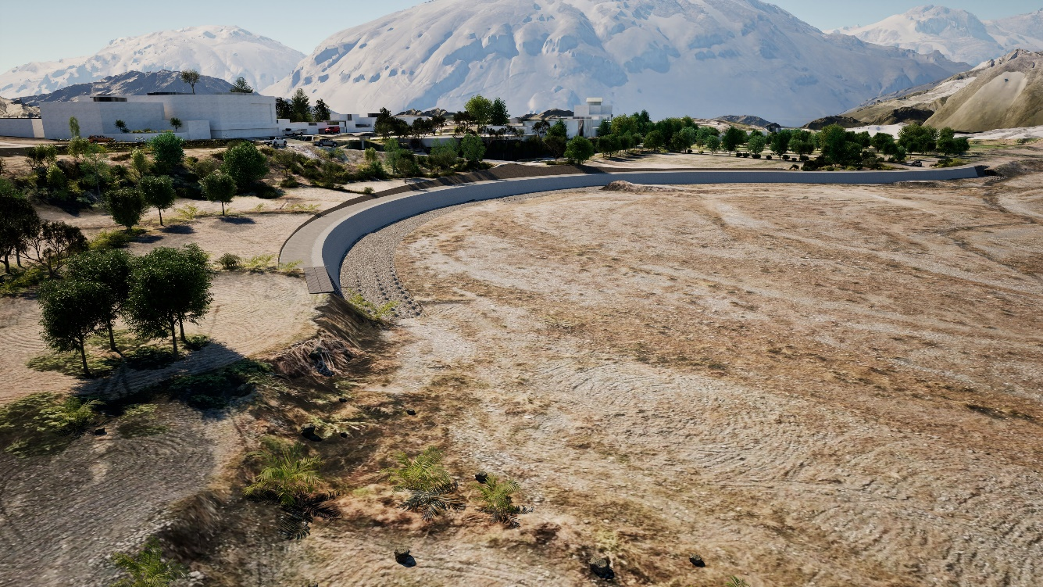
3D Image of Concrete Revetment in Ali Khan
(Height:6.4m, Length:287m)
II. Construction of Facility
FLOW
Bank erosion
Normal Condition
Before Project
After Project
FLOW
Flood Condition

Slide 27
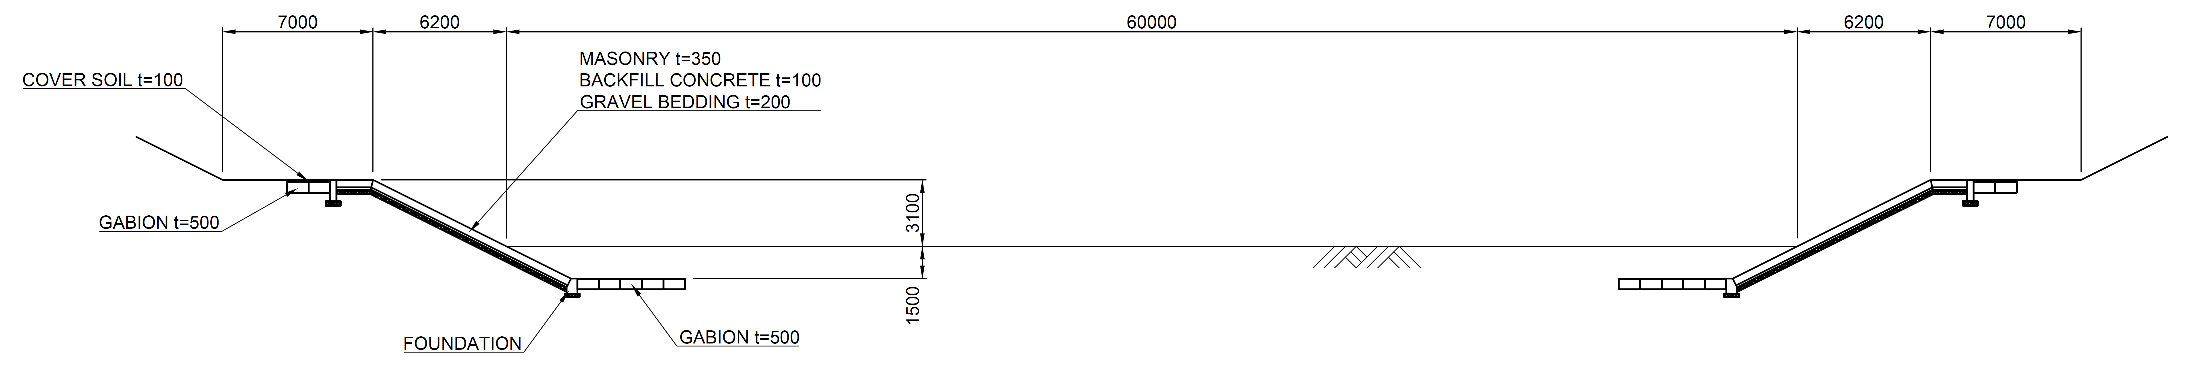
II. Construction of Facility
3. Sikandarpur
Scope of the Work:
Construction of Floodway with Concrete Revetment (Height: 3.1m, Length:1,065m) to carry flood flow safely
FLOW
FLOW
2-3 years flood: 500m3/s

Slide 28
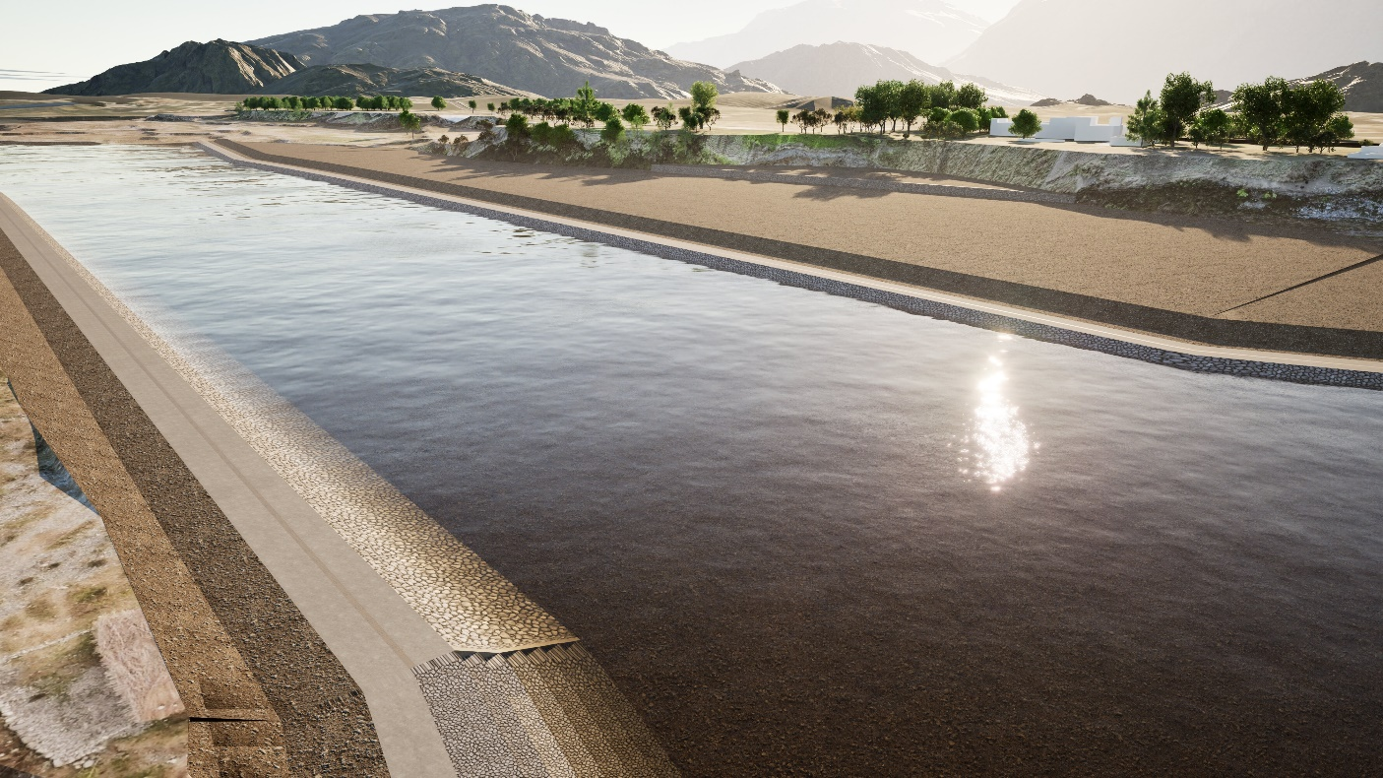
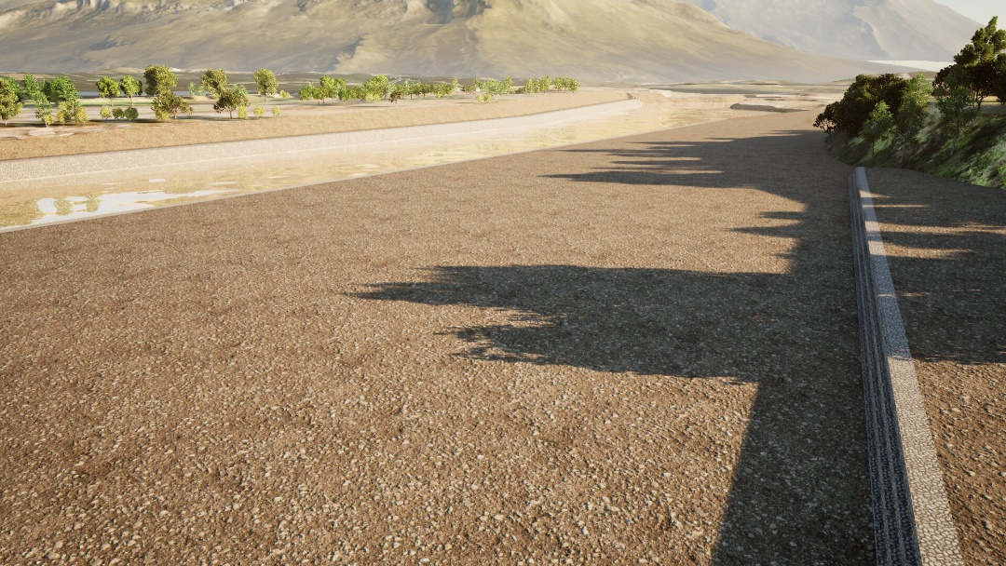
3D Image of Floodway in Sikandarpur
(Height: 3.1m, Length: 1,065m)
II. Construction of Facility
Right bank : 541m
Left bank : 524m
FLOW
During Flood
FLOW
Normal Condition

Slide 29
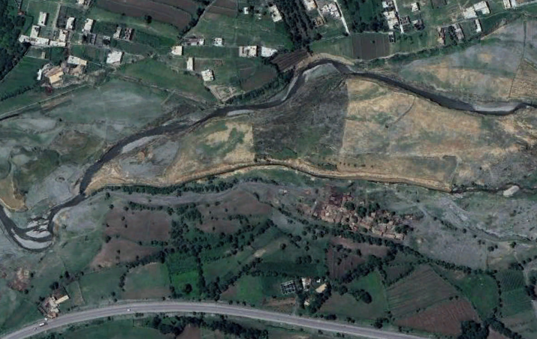
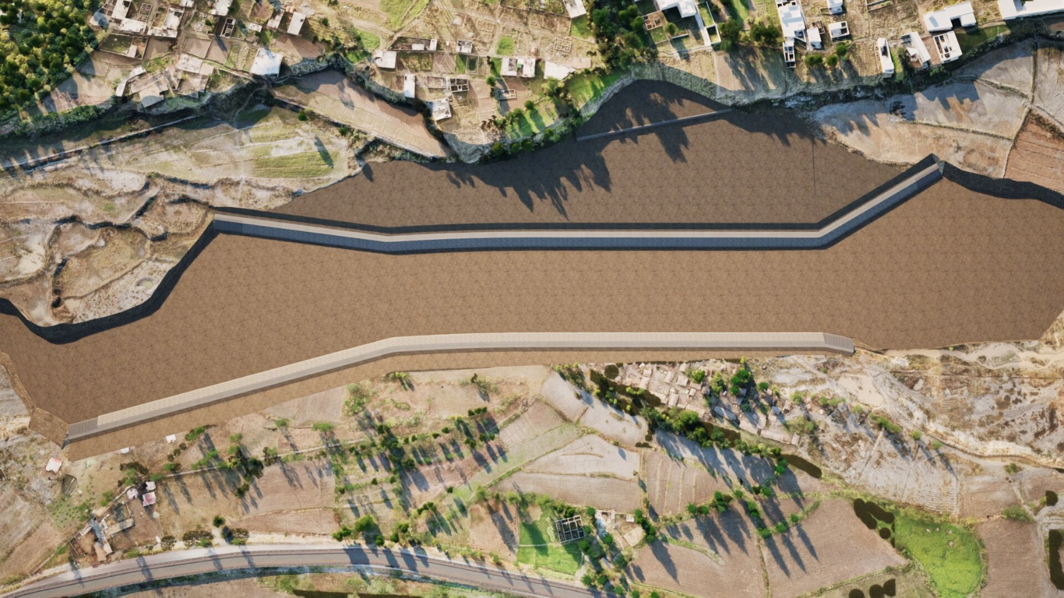
3D Image of Floodway in Sikandarpur
(Height: 3.1m, Length: 1,065m)
II. Construction of Facility
Bank erosion
FLOW
Before Project
After Project
FLOW

Slide 30
Project Schedule of River Improvement (Construction of River Structure)
II. Construction of Facility
Monsoon Season
※ Since construction works are carried out within river area, construction schedule is planned to avoid monsoon season for safety reasons. Construction works within river area are scheduled to be carried out from November to April.

Slide 31
Undertakings by Pakistan Side (1/2)
II. Construction of Facility
No. | Item
1. General Items
1-1 | Implementation of all necessary institutional and legal procedures in Pakistan
1-2 | Concluding a Bank Arrangement (B/A) with a bank in Japan and opening an account in the name of the government.
1-3 | Payment of bank fees for the issuance of Authorization to Pay and modifications to the Authorization to Pay for consultants and contractors
1-4 | Provision of necessary documents to customs agents/transporters (employed by the contractor) for tax exemption procedures and customs clearance at the unloading port for equipment and materials imported for this project, as well as procedures for repairing/replacing/re-importing equipment and/or spare parts at the manufacturer's factory if defects occur during the project implementation period and the defect liability period
1-5 | Guarantee of visa issuance (including extensions) and necessary procedures for personnel involved in this project who hold nationalities of Japan and other countries (including dependent countries), and matters necessary for entering and staying in Pakistan
1-6 | Exemption from customs duties, internal taxes, and other taxes imposed in the recipient country for personnel involved in the implementation of this project, who hold nationalities of Japan and other countries (including dependent countries), related to the supply of products and services based on the contract
1-7 | Obtaining NOCs/permissions/consents/approvals from the landowners where the river structures are to be installed
1-8 | Implementation of environmental impact assessment procedures required in Pakistan (if necessary)
1-9 | Prompt unloading and customs clearance at the unloading port, and support for domestic transportation

Slide 32
Undertakings by Pakistan Side (2/2)
II. Construction of Facility
No. | Item
2. Safety Measures
2-1 | Maximum measures for safety and ensuring the safety of personnel involved in the implementation of this project, who hold nationalities of Japan and other countries, at each site before and during the project implementation period
2-2 | Arranging escort security by local police for consultants and contractor personnel during their accommodation and travel to the river structure installation sites
3. Installation of Structures
3-1 | Removal and relocation of existing structures, if necessary, to install structures at the selected river structure installation sites
3-2 | Provision of workspaces with internet access for consultants and contractors at FFC Islamabad during the construction period of the project
3-3 | Provision of secure temporary storage locations/rooms/warehouses for storing materials, tools, and equipment necessary during the project implementation
3-4 | Securing and leveling the land/sites necessary for the project implementation (e.g., construction roads, temporary storage yards for materials) before the project implementation
4. After Project Completion
4-1 | Proper operation and maintenance of structures developed in this project
4-2 | Assignment of personnel with technical skills and extensive experience, including those responsible from KP-PID, for the proper operation and maintenance of structures developed in this project
4-3 | Implementation of regular inspections for the maintenance of structures
4-4 | Appropriate repair of damaged areas caused by floods and maintenance of access roads for the maintenance of structures

Slide 33
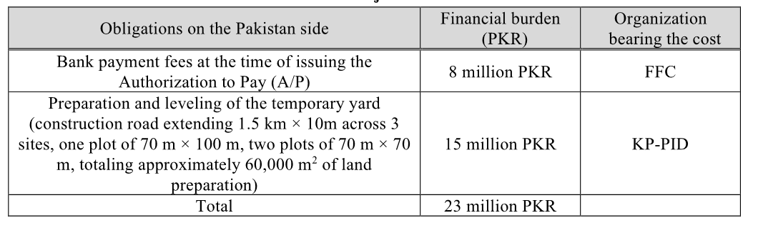
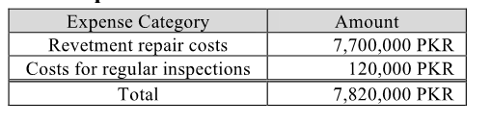
Estimated Cost by KP-PID
II. Construction of Facility
Initial Cost
O&M Cost
And Land Acquisition

Slide 34
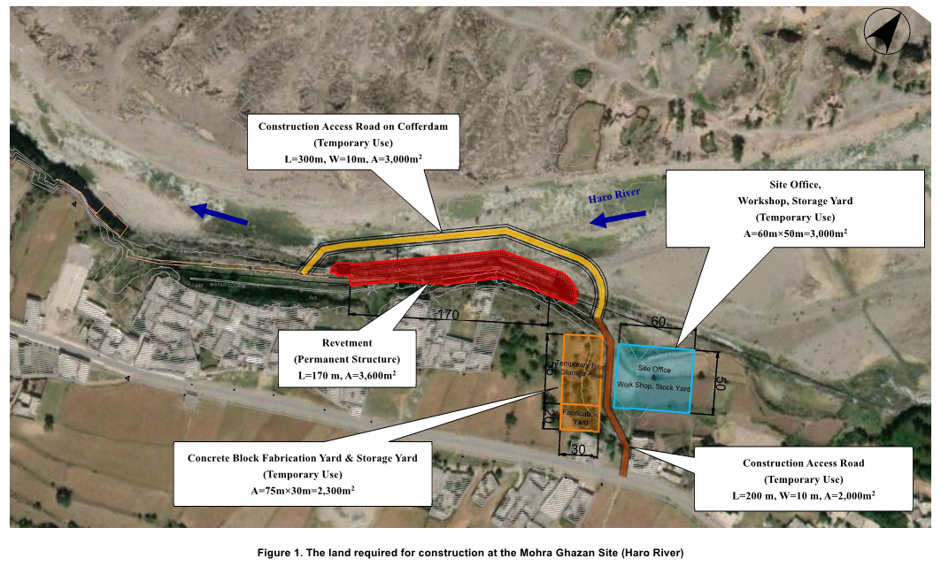
II. Construction of Facility
Land Acquisition for River Improvement in Mohra Ghazan

Slide 35
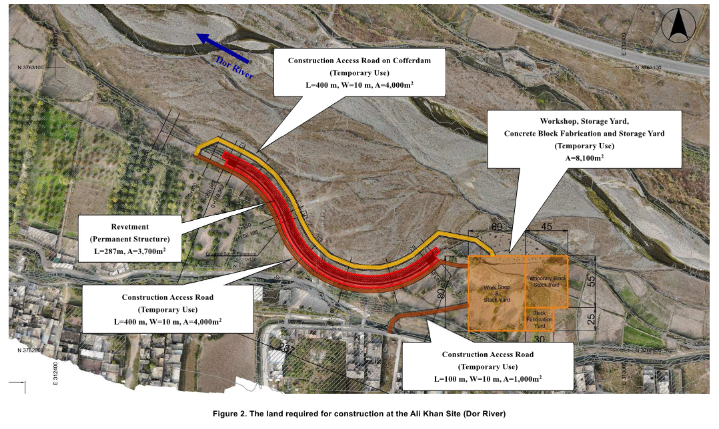
II. Construction of Facility
Land Acquisition for River Improvement in Ali Khan

Slide 36
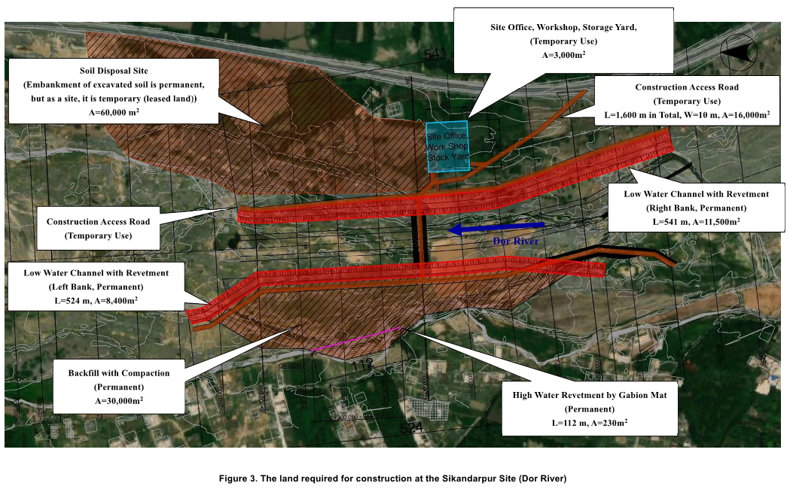
II. Construction of Facility
Land Acquisition for River Improvement in Sikandarpur

Slide 37
Requests for Cooperation on PC-1
I. Procurement of Equipment
II. Construction of Facility
Early approval of PC-1 is required on the Pakistani side to get approval of Japanese Cabinet on Implementation of Japan’s Grant Aid Project.
Strong support from WAPDA, KP-PID, FFC and EAD is indispensable for the early approval of PC-1. Such efforts will be highly appreciated.
If there is any work to accelerate approval of PC-1 that can be done by JICA consultant team, we would be happy to help.

Slide 38
I. Procurement of Equipment
II. Construction of Facility
Required Process for PC-１ and Japanese Cabinet Approval

Slide 39

Thank you for your attention.
Japan International Cooperation Agency
CTI Engineering International Co., Ltd.
International Meteorological Consultant Inc.

