Slide 1
(Army Pre Flood Coordination Conference-2024) FLOOD PREPAREDNESS PLAN (FLOOD SEASON 2024) Irrigation Department 6th June, 2024
GOVERNMENT OF KHYBER PAKHTUNKHWA

Slide 2
Role of Irrigation Department during Flood Season
Establishment of Provincial Flood Emergency Cell at Peshawar headed by XEN Hydrology.
Flow measurement at specific sites on rivers, canals and nullahs.
Collection of flow data and dissemination of Daily Flood Situation Report (DFSR) to relevant organizations*.
Flood fighting to protect flood mitigation structures during Emergency on Indus River in D.I Khan only.
* H/Q 11-Corps, NDMA, PDMA, Police Department, Civil Secretariat, Relief Commissioner, Director Information Khyber Pakhtunkhwa, District administration, Federal Flood Commission, Cabinet Division Islamabad, IRSA etc.

Slide 3
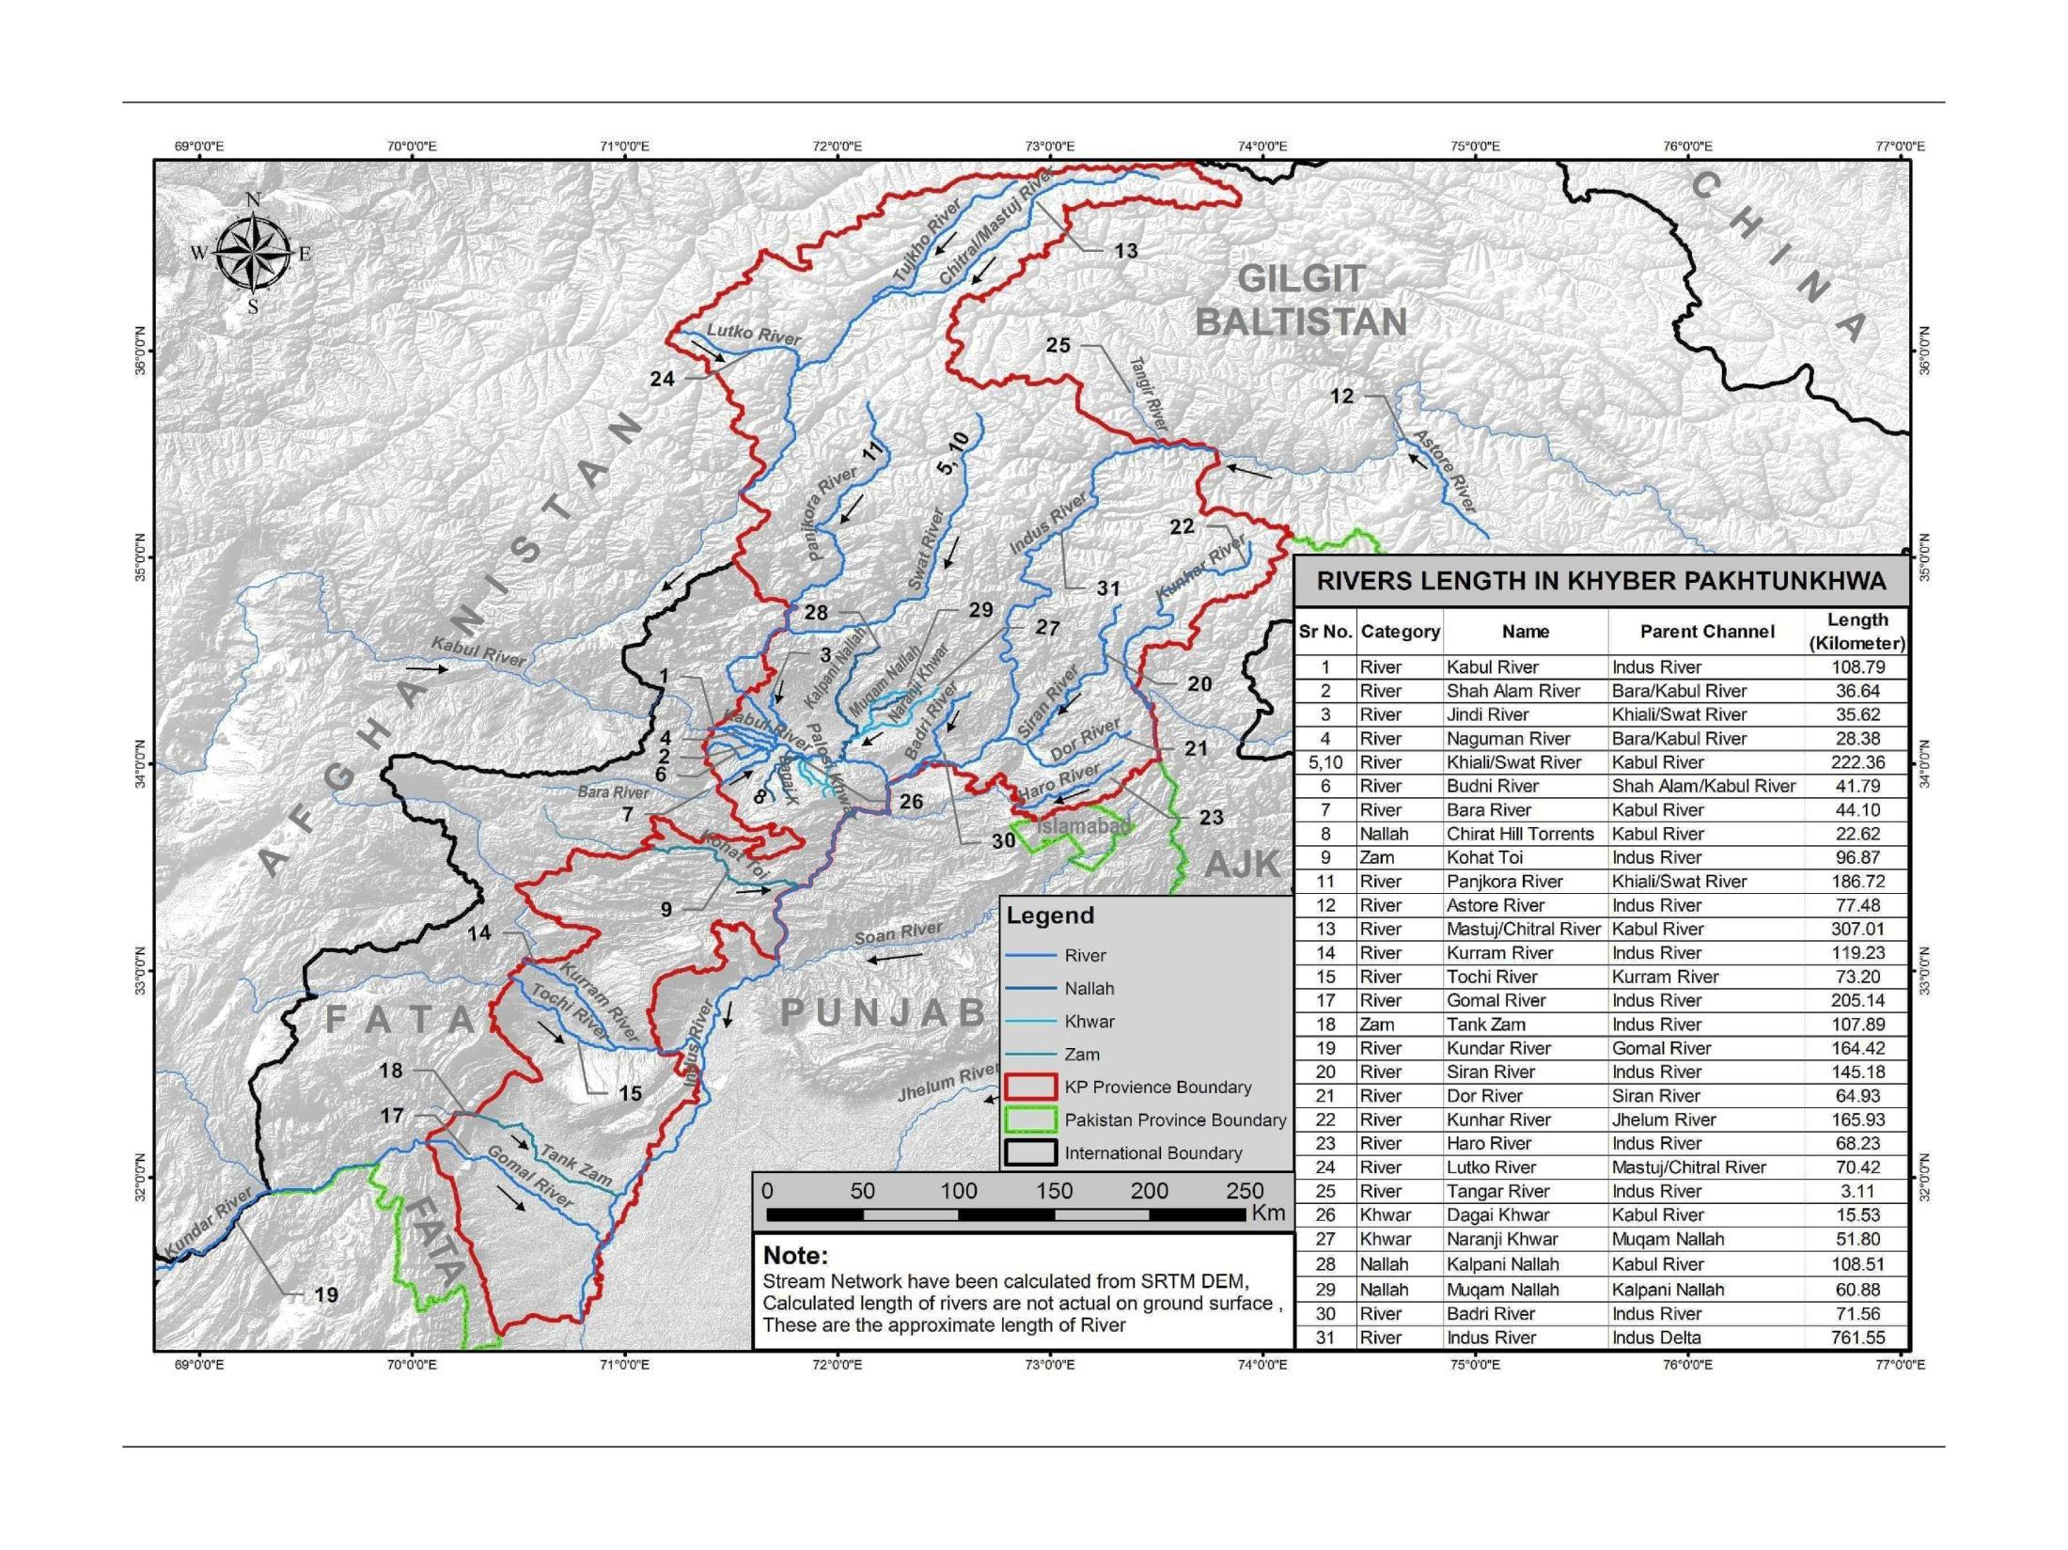
GOVERNMENT OF KHYBER PAKHTUNKHWA
IRRIGATION DEPARTMENT
Khyber Pakhtunkhwa has a vast area of 74521 Sq Km. The Irrigation Department operates and manages the entire system of River Indus tributaries as well as hill torrents. All the tributaries having extensive catchment areas extended from North and North-West of Pakistan consist of various mountain ranges, receive heavy rainfall in monsoon season every year, thus causing tremendous flood in its drainage lines (water ways) in the province. Irrigation Department has flood fighting infrastructure on various rivers/streams and maintain them in functional position for safety of human lives and precious properties.
There is no practice of flood fighting in other rivers of Khyber Pakhtunkhwa except Indus River from Chashma to Ramak in DIKhan, where several number mega flood mitigation structures have so far been constructed. The flood fighting is carried out during emergency in flood season for the protection of flood protection infrastructure so as to ensure saftey of adjoining abadies and population along right bank of river Indus.

Slide 4
TIME LAG OF RIVERS IN KHYBER PAKHTUNKHWA
S.No | Location | Distance in KM | Time Lag Hours
 | SWAT RIVER
i. | Khawaza Khela to Amandara | 65 | 12 hours
ii. | Amandara to Munda | 85 | 9 hours
iii. | Munda to Charsadda Road | 40 | 6.5 hours
iv. | Charsadda Road to Nowshera | 35 | 6 hours
 | KABUL RIVER
i. | Warsak to Nowshera | 60 | 10 hours
 | INDUS RIVER
i. | Jinnah Barrage to Chashma Barrage | 56 | 4.5 Hours
ii. | Chashma Barrage to D.I.Khan | 100 | 15 -17 hours
iii. | D.I.Khan to Ramak | 70 | 9 hours

Slide 5
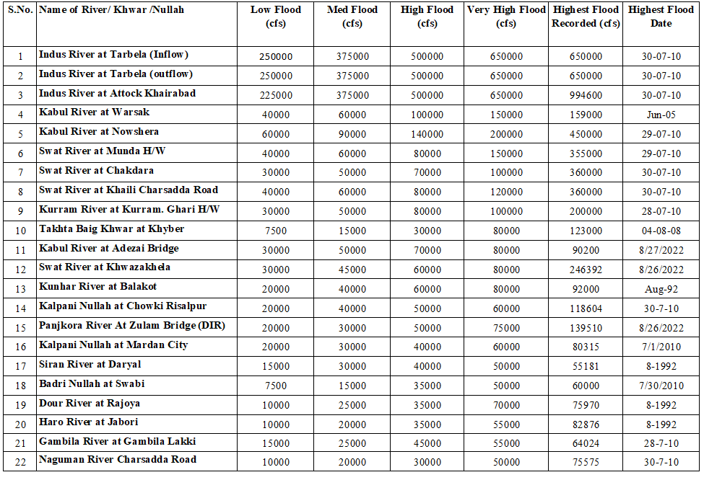
Discharge Limit Chart-Rivers/Nullahs in Khyber Pakhtunkhwa

Slide 6
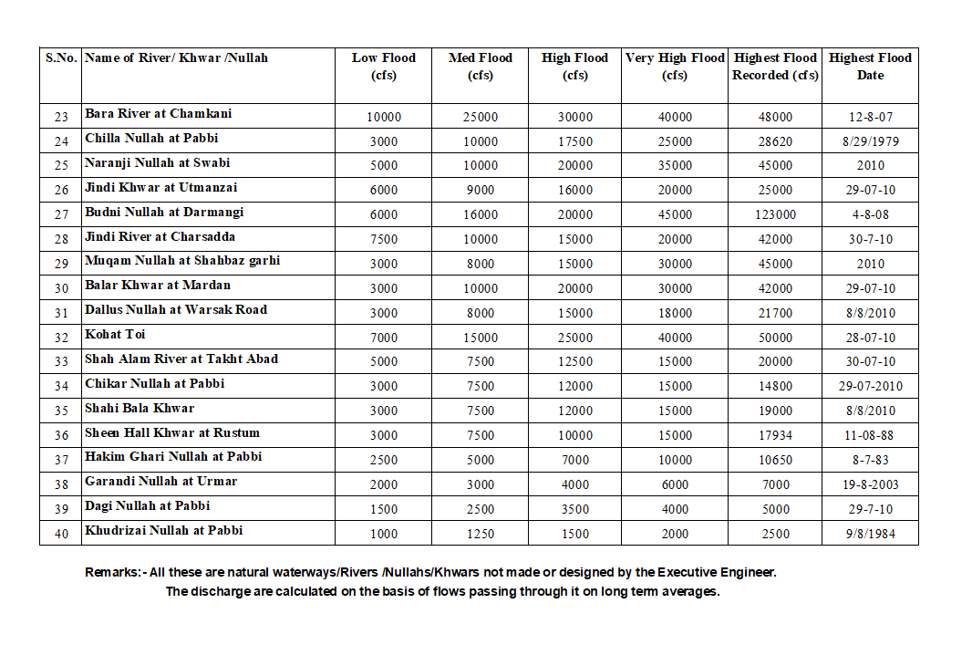

Slide 7
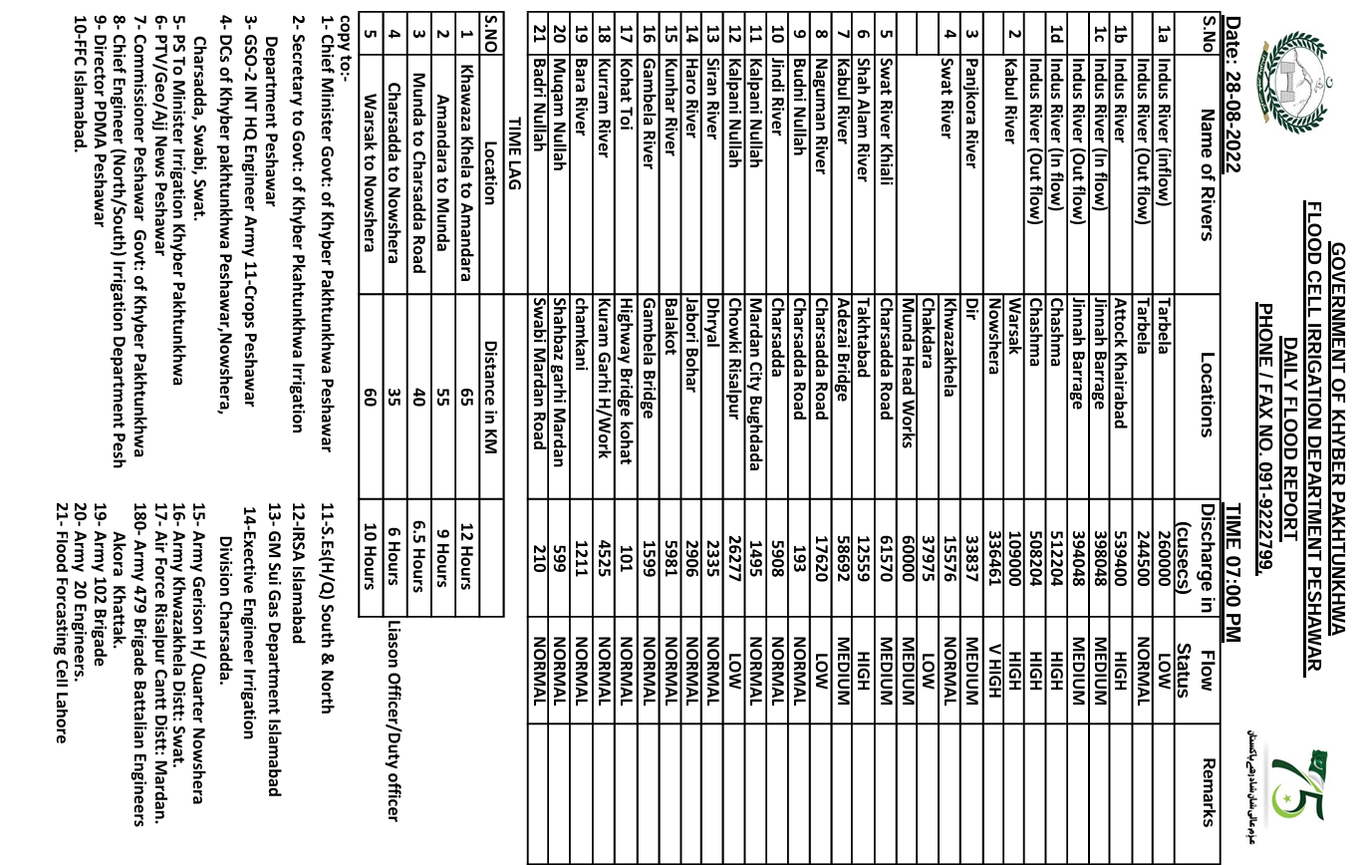
TYPICAL DAILY FLOOD SITUATION REPORT(DFSR)

Slide 8
Flood Contingency Plan, 2024
Flood Emergency Cell at regional office Peshawar has been established and is operational since 22nd April 2024 .
Local Flood Emergency Cells established in the offices of the Executive Engineers in the flood prone districts.
Rehabilitation & calibration of damaged gauges has been completed.
Emergency supervisory staff will be deployed on barrages and head works before the onset of Monsoon Flood Season.
Barrages, Head works and other Irrigation installation are being operated under Standard Operating Procedure (SOP) to deal with emergencies arising out of Flood situation.
Pre-flood inspection of Barrages, Head Works, Escape gates have been carried out.

Slide 9
Emergency Flood Contingent Plan for D.I Khan
Emergency tenders for flood works will be finalized by15th June 2024.
Emergency gangs will be engaged by the contractors on all vulnerable locations.
Additional supervisory staff will be deployed on marginal bund.
The earth moving machinery will be deployed at vulnerable locations. The contractors will arrange machinery from open market during emergency.
Executive Engineer, Flood Division has shared contingency plan with the Deputy Commissioner, accordingly vigilance committees will be notified.
Close liaison would be ensured amongst the field staff of the Department and all concerned agencies.

Slide 10
Flood Mitigation Structures.
No. | Description | Length (Km)
1. | Spurs along Indus river in D.I.Khan (U/S bridge 32 and D/S bridge 13) | 61
2. | a. Total length of Guide Bund b. Total length of Marginal Bund c. Total length of Flood Embankment | 6 37 10.5

Slide 11
Post Floods 2022
Irrigation Infrastructure Damages
The assessed value of damages to irrigation and drainage infrastructure amounted to Rs. 22,386 million.
03 No. Bays of Munda Head Works were fully washed away due to extreme flood in Swat river.
Flood protection works/embankments constructed along Kabul & Swat river also received severe damage due to erosive action as well as overtopping.
The Main Chashma Right Bank Canal (CRBC) was damaged at more than 140 places and a major portion about 3Kms of main Canal has been washed away.
The flood protection embankments on right side of Main CRBC was washed away in different reaches in a length of 90 Kms.
Flood Carrier Channels (FCCs) were also badly damaged in D.I Khan.

Slide 12
Post Floods 2022
Irrigation Infrastructure Damages--Contd
Various distributaries/minors of CRBC & Paharpur Canal Network were also partially damaged.
In Chitral, 60 channels suffered damage, with the estimated cost of their restoration being approximately Rs. 336.50 million. Additionally, flood protection works amounting to Rs. 1280.50 million were reported as damaged.
Mansehra Irrigation Division reported that , 25 channels suffered damages, with the estimated cost of their restoration being approximately Rs. 220.60 million. Additionally, flood protection works amounting to Rs. 445.50 million were reported as damaged.
All over the province damages to the Irrigation infrastructures and public and private properties were also observed.

Slide 13
POST FLOOD 2022, RESTORATION/REHABILITATION PORTFOLIO
S.# | Name of Scheme | Cost of PC-I (Rs in M) | No of Sub Works | Releases (Rs in M) | Expenditure (Rs in M) | Progress %age
 |  |  |  |  |  | Physical | Financial
1 | 220955-Restoration of damaged flood structures and drainage system in Khyber Pakhtunkhwa. | 3245.00 | 97 | 721.81 | 721.81 | 55% | 22.24%
2 | 20956-Restoration of Water Supplies in Irrigation System and Channels in Khyber Pakhtunkhwa | 2457.00 | 112 | 524.27 | 524.27 | 90% | 21.33%
3 | 220962-Restoration and Rehabilitation of Patrol Roads/Bridges along Canals and Drains damaged in flood 2022 throughout Khyber Pakhtunkhwa. | 580.0 | 4 | 53.57 | 53.57 | 30% | 9.23%
4 | 220961-Rehabilitation of damaged flood protection structures in Khyber Pakhtunkhwa (Phase-I) | 1300 | 16 | 300 | 300 | 50% | 23%
 | Sub Total:- | 7582.00 | 229 | 1599.65 | 1599.65

Slide 14
POST FLOOD 2022, RESTORATION/REHABILITATION PORTFOLIO
S.# | Name of Scheme | Cost of PC-I (Rs in M) | No of Sub Works | Releases (Rs in M) | Expenditure (Rs in M) | Progress %age
 |  |  |  |  |  | Physical | Financial
5 | 220998-Reconstruction and Rehabilitation of Irrigation, System and Flood Protection Works in Khyber Pakhtunkhwa. (ADB) | 12118.0 | 143 | ADB Assisted Project. 20 Nos schemes completed. Detail design for the remaining schemes have been completed. Tenders are in process.
6 | 220961-Rehabilitation of damaged flood protection structures in Khyber Pakhtunkhwa (Phase-II) | 5978.17 | 173 | Awaited for approval of PDWP
7 | 220960-Rehabilitation of damaged Irrigation system and channels in Khyber Pakhtunkhwa | 3203.90 | 160 | Awaited for approval of PDWP
 | Sub Total:- | 21300.07 | 476
 | Grand Total | 28882.07 | 705 | 1599.65 | 1599.65

Slide 15
Detail Major Flood Protection Projects (09 Nos) (Rs in Million)
S # | ADP # | Name of the scheme | Estimated cost (m) | Total length (km) | Physical progress | Expenditure | Liability | Remarks
 | A | Peshawar Canals Division Peshawar
1 | 2158 | 170665-Construction of Flood Embankment on Kabul River Upper side of Motorway Interchange District Nowshera | 1060.18 | 7.47 | 85% | 905.346 | 154.834 | In Progress
2 | 2144 | 160459-Construction of flood structures along Jabba Daudzai & Zangal Korona area along kabul river & Shah Alam river District Nowshera & Peshawar | 1482.98 | 12.15 | 83% | 1051.04 | 196.006 | -do-
3 | 2103 | 140523-Construction of Flood Embankment on Right side of Kabul River (Reach No. 1) District Nowshera | 713.243 | 7.03 | 93% | 649.118 | 64.125 | -do-
4 | 2104 | 140524-Construction of Flood Embankment on Right side of Kabul River (Reach No. 2) District Nowshera | 943.10 | 6.35 | 91% | 826.516 | 116.584 | -do-
5 | 2105 | 140525-Construction of Flood Embankment on Right side of Kabul River (Reach No. 3) District Nowshera | 2311.93 | 25.10 | 98% | 2268.728 | 43.202 | -do-
6 | 2118 | 150383-Construction of Protection Structure on Right Side of Kabul River U/s & D/s Nowshera Mardan Road Bridge, District Nowshera. | 3023.681 | 22.24 | 100% | 2981.151 | 42.53 | Completed
 |  | Sub Total A:- | 9299.18 | 80.34 |  | 8681.899 | 617.281
 | B | Charsadda Irrigation Division Charsadda
7 |  | 140526 - Construction of Flood Embankment from Kheshki to Nowshera Kalan on Left Side of Kabul River, District Nowshera | 1396.438 | 9.14 | 100% | 1396.438 | - | Completed
8 |  | 150715 - Construction of Protection Structures on L/S of Kabul River U/S and D/S Nowshera Mardan Road Bridge, District Nowshera | 1138.352 | 5.36 | 100% | 1138.352 | - | Completed
9 | 1378 | 170664 - Construction of Flood Embankment from Kheshki village to Motor way Bridge L/S Kabul River District Nowshera/Charsadda (Reach-1) | 1512.89 | 6.85 | 80% | 1207.277 | 305.613 | In Progress
 |  | Total B:- | 4047.68 | 21.35 |  | 3742.167 | 305.613
 |  | G.Total:- | 13346.86 | 101.69 |  | 12424.066 | 922.894

Slide 16
HFL
HFL

